Slide 3
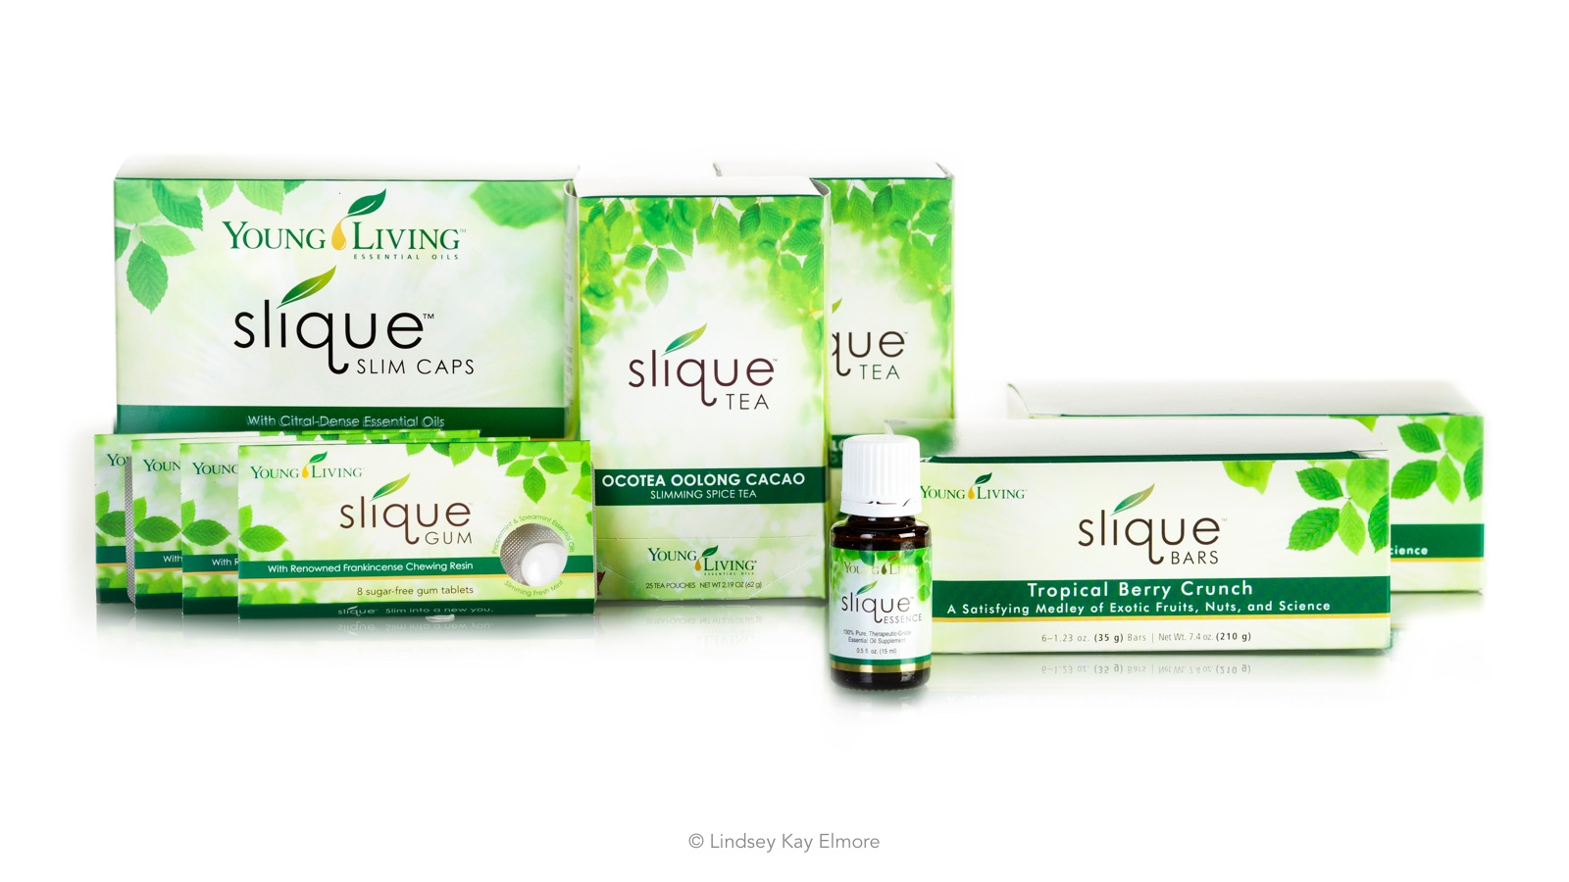

Slide 5
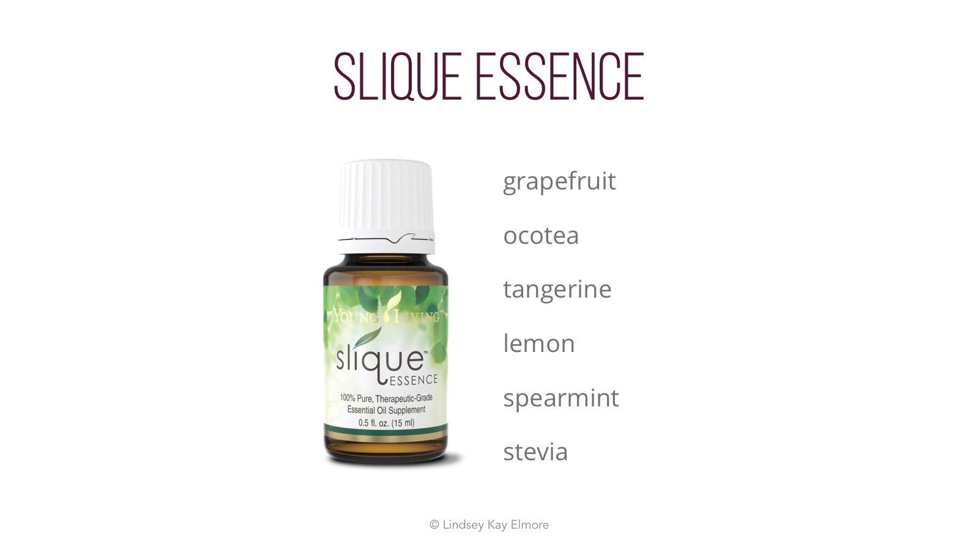
Notes:
Slique essence is a slightly sweet essential oil blend that has a blend of citrus oils with spicy ocotea and sweetened with naturally occurring Stevia.
Stevia: Purified extracts from the Stevia plant gives steviol glycosides which is broken down into steviol which is absorbed by the body. The body does not store steviol glycosides and they are rapidly broken down or eliminated from the body. Because it is sugar-free is doesn't feed Candida, is benign to the teeth, doesn’t contain sugar.
But it causes infertility! This concern is based on 2 studies that are both 30 years old. In 1968, Professor Joseph Kruc, a member of Purdue University’s department of biochemistry conducted a study of Stevia at the University of the Republic in Montevideo. Giving a small number of rats very high doses of stevia, it was concluded that the rats given the herbal extract produced less offspring than those who were not.
The problem, even Kruc admits today, is that the rats in the study were given such high doses of Stevia for such a short period of time, that even if it did cause the fertility problems noted, it could have been because of an overdose of the compound. People ingesting Stevia as a sweetener would never be able to consume such a large amount in such a short period of time.
Another concern Kruc admits is that there is no evidence to show that the reaction experienced by the rats would also be experienced by humans.
The Alvarez Study In 1988, professor Mauro Alvarez of Brazil’s University of Maringa Foundation, repeated the study, reporting in a Brazilian pharmaceutical journal that female mice given Stevia experienced a contraceptive effect similar to those reported by Kruc.
The problem with the results, argue critics is that the Alvarez study lacks the information and analysis required by such a research study and can not be considered valid. According to the Herb Research Foundation the study lacks any credibility at all and should be disregarded.
Even Alvarez himself now claims that further research has led him to believe that Stevia is completely safe for human consumption.
Despite the problems with both studies, the FDA continues to use them as their main source against Stevia.
Overall the FDA recognizes stevia as GRAS and the British government recognizes it as safe even in relatively large doses.
Mutagenic! Damages DNA! That’s not what the data demonstrates in a 2008 study where steviol and steviol glycosides were exposed to Wistar rat tissue, there was no evidence that the compounds interacted with DNA nor did they display genotoxic damage.
Stevia causes allergies. Yes. It is a natural product and a foreign substance in the body, and it is possible to be allergic to it.
Hypoglycemia: Demonstrated to lower blood fasting and post-prandial blood sugar in patients with diabetes. Also reduced VLDL and triglycerides. In rats with alloxan-induced diabetes, stevia was found to decrease blood sugar without hypoglycemia that is commonly associated with sulfonylurea medications.

Slide 6
Notes:
Gluten free, vegan, soy, dairy and nut free, and raw. Blend of protein from protein, quinoa, wolfberry, pumpkin seed protein, alfalfa grass juice. Berry flavored. 220 calories if blended with 1 cup of almond milk. Average calorie intake per day in the US is 3770, so if there are 3 meals per day that is 1256 calories per meal! Given that the recommended caloric intake per day is 2000 for women and 2400 for men, substituting Slique Shake for one meal per day would shave off over 1000 calories from your daily intake which would get down to 2770 calories per day. Now, we know that in order to burn one pound of fat you need to burn 3500 calories, so if you decrease your caloric consumption by 1000 calories per day, this could lead to a weight loss of 2 lbs per week. Now, it may not be sustained at this rapid pace because of the metabolic defense of weight, but it can be a great way to get started. Also in the US Americans spend an average of $150-170 every week on food or up to $8 per meal. At just over $3/pack, you can also save money while supporting healthy body weight.

Slide 7
Notes:
Formulated with ingredients to help burn fat
Supports a healthy metabolism
Unique formula features plant-based extracts that help support healthy weight management and healthy energy levels
Formulated with a proprietary citrus fruit-based blend, which may help support the body in burning excess fat when used in conjunction with a healthy-weight management plan
May help support the breakdown of triglycerides that are stored in the body’s fat tissue
May support the release of free fatty acids that help break down fat and help to produce additional energy
Formulated with citrus extracts and other plant-based ingredients known for their polyphenols and antioxidant activity
Reduces oxidative stress.
Vegan
Plant Based Polyphenols: Broad group of molecules named for the multiple phenol structures in the back bone. The health benefits of polyphenols are hard to measure because their effect on the body is multiplicative. However, in regards to weight loss, foods and drinks high in polyphenols are known in ayurvedic medicine as astringents and astringents can shrink body tissues. Leads to dry shrinking sensation in the mouth that you might find when you eat certain fruits like pomegranate, quince or persimmon.
Sinetrol. Decrease waist and hip circumference, decreased abdominal fat. Shown in clinical studies to increase lean mass while decreasing fat mass. Protect against oxidative stress (measured in clinical trials as a decrease in malondialdehyde and an increase in superoxide dismutase and glutathione.

Slide 8
Notes:
Slique Tea is an exotic drink from Young Living that has been formulated with natural ingredients to help support individual weight goals.* This blend is rich in flavonoids, a dietary compound generally associated with helping maintain certain normal, healthy body functions. It also contains polyphenols, which may be useful as part of a guilt-free weight-management regimen when combined with a healthy diet and physical activity. This unique blend is enhanced with 100% pure therapeutic grade Frankincense powder.
Chicory Inulin: fibrous oligosaccahride similar to a prebiotic that is converted into short chain fatty acids and then into ketones to help nourish the body. Mildly sweet flavor. Studies have examined inulin for both how it can support normal blood sugar and support healthy weight. absorbs water, and forms a gel-like compound, takes up a lot of space in the stomach, helps you feel fuller longer, and helps to form poo
You can enhance the potency of the chocolate flavor in the tea by squeezing the bag against the side of a mug, to release additional cocoa flavor from the nibs. Or you cannot, and have more of the oolong tea flavor instead.

Slide 9
Notes:
Members have always enjoyed Slique Bars as a safe, delicious weight-management tool that utilizes a dual-target approach to help manage satiety. Now this innovative bar is coated in delicious dark chocolate! To support any weight-management plan, Slique Bars are loaded with exotic baru nuts and wholesome almonds, which promote satiety when combined with protein and fiber. We also use a potato skin extract that, when ingested, triggers the release of cholecystokinin in the body, increasing the duration of feelings of fullness.* Slique Bars deliver essential nutrients from a unique superfruit blend of goldenberries and wolfberries, plus pure Cinnamon, Vanilla, and Orange essential
oils. This dual-target satiety approach and medley of exotic fruits, nuts, and potato skin extract create a nutritious, stimulant-free snack to help you feel fuller, longer.
Manages satiety. Potato skin extract triggers the release of cholecystokinin (CCK) in the body, increasing the duration of feelings of fullness.
A mix of exotic nuts and berries, featuring baru nuts, goldenberries, and wolfberries,delivers delicious taste and promotes fullness when combined with protein and high levels of fiber
A proprietary essential oil blend of Cinnamon, Vanilla, and Orange essential oils helpsmoderate cravings.
High in fiber • Gluten-free • No trans fat • No preservatives • Manages satiety. • Potato skin extract triggers the release of cholecystokinin (CCK) in the body, increasing the duration of feelings of fullness. • A mix of exotic nuts and berries, featuring baru nuts, goldenberries, and wolfberries, delivers delicious taste and promotes fullness when combined with protein and high levels of fiber. • A proprietary essential oil blend of Cinnamon, Vanilla, and Orange essential oils helps moderate craving
CCK is a peptide hormone that is rapidly released from the small intestine after a meal. It triggers the release of digestive enzymes. It also helps to delay gastric emptying making you feel fuller longer. Interestingly animal data suggests that the impact may be greater on older rats than younger rats, perhaps indicating that older people could glean more benefit from CCK.
Contains Baru nuts so it is not nut free, and this ingredient again gives very high levels of phenolic compounds.
POT

Slide 10
Notes:
Frankincense Resin (Boswellia frereana), Gumbase, Isomalt, Sorbitol, Natural Flavors, Calcium Stearate, Natural Sweeteners, Colors (Red Cabbage Juice, Turmeric,), Slimming Fresh Mint Essential Oil Blend: (Peppermint (Mentha Piperita) Oil, Spearmint (Mentha Spicata) Leaf Oil], Xylitol
Xylitol is a natural sweetener derived from the fibrous parts of plants. It does not break down like sugar and can help keep a neutral pH level in the mouth, and when we keep the Ph of the mouth within normal limits we ensure that bacteria do not have a good growth . Xylitol also prevents bacteria from sticking to the teeth

Slide 12
