Slide 2
Notes:
NingXia Red every morning
NingXia Nitro before exercise, studying or in an afternoon slump at work
NingXia Zyng during the day to avoid sugary sodas

Slide 3
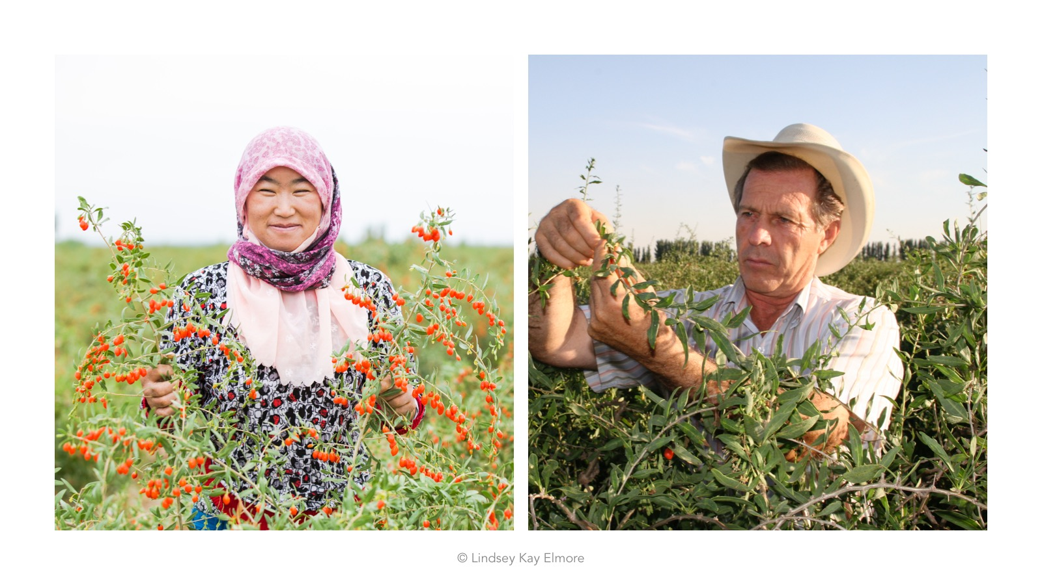

Slide 4
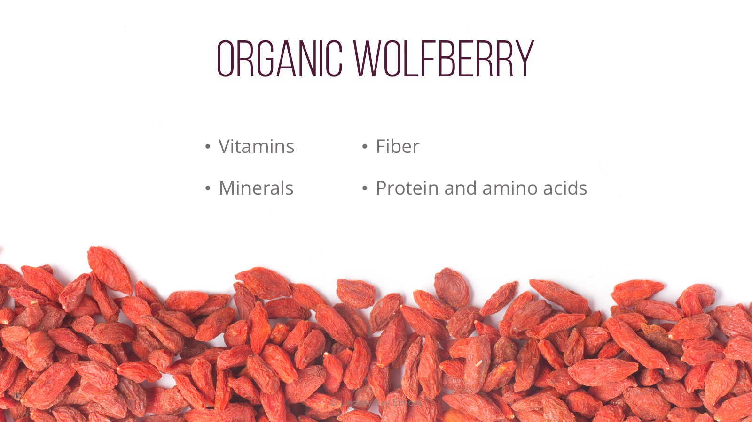

Slide 5
Notes:
Vegetarian

Slide 6
Notes:
Bioenergy Ribose
Vanilla
Chocolate
Yerba Mate
Spearmint
Nutmeg
Peppermint
Black pepper
Wolfberry seed oil

Slide 7
Notes:
These are the ingredients in Nitro which support energy, and mental and cognitive alertness. Nitro combines Korean Ginseng, Green tea extract, and Mulberry leaf extract.

Slide 8
Notes:
BER is a form of d-Ribose that has been clinically tested for its ability to increase endurance, energy, and aerobic capacity. BER is also the backbone of ATP. ATP is the energy molecule of all living cells.
Non-GMO
Naturally occurring
Kosher and Halal certified
FDA GRAS
Highest quality in the industry

