Slide 3
Notes:
Insomnia
Adrenaline dump or “crash”
Diarrhea
Headache
Upset stomach
Flushing of the skin (from beta alanine)
Dehydration
Jitters
The body can adapt to the stimulants quickly
Increase blood pressure
Kidney and Liver Failure

Slide 4
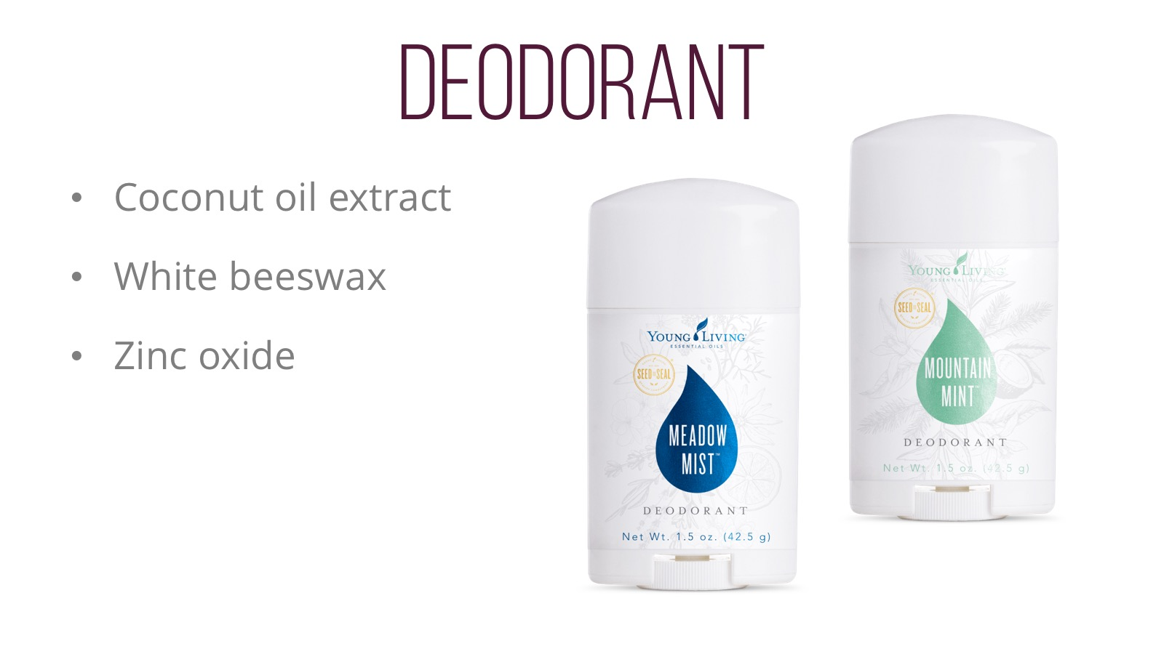

Slide 5
Notes:
Bioenergy Ribose
Vanilla
Chocolate
Yerba Mate
Spearmint
Nutmeg
Peppermint
Black pepper
Wolfberry seed oil

Slide 6
Notes:
These are the ingredients in Nitro which support energy, and mental and cognitive alertness. Nitro combines Korean Ginseng, Green tea extract, and Mulberry leaf extract.

Slide 7
Notes:
Bioenergy Ribose (BER) is a form of d-Ribose that has been clinically tested for its ability to increase endurance, energy, and aerobic capacity. BER is also the backbone of ATP. ATP is the energy molecule of all living cells.
Non-GMO
Naturally occurring
Kosher and Halal certified
FDA GRAS
Highest quality in the industry

Slide 8
Notes:
35 calories per can
No artificial flavors
No artificial sugars
Preservative free
Black pepper essential oil
Lime essential oil
Wolfberry puree
White tea extract
Vitamins A, E, B3, B5 and B6

Slide 9
Notes:
Members have always enjoyed Slique Bars as a safe, delicious weight-management tool that utilizes a dual-target approach to help manage satiety. Now this innovative bar is coated in delicious dark chocolate! To support any weight-management plan, Slique Bars are loaded with exotic baru nuts and wholesome almonds, which promote satiety when combined with protein and fiber. We also use a potato skin extract that, when ingested, triggers the release of cholecystokinin in the body, increasing the duration of feelings of fullness.* Slique Bars deliver essential nutrients from a unique superfruit blend of goldenberries and wolfberries, plus pure Cinnamon, Vanilla, and Orange essential
oils. This dual-target satiety approach and medley of exotic fruits, nuts, and potato skin extract create a nutritious, stimulant-free snack to help you feel fuller, longer.
Manages satiety. Potato skin extract triggers the release of cholecystokinin (CCK) in the body, increasing the duration of feelings of fullness.
A mix of exotic nuts and berries, featuring baru nuts, goldenberries, and wolfberries,delivers delicious taste and promotes fullness when combined with protein and high levels of fiber
A proprietary essential oil blend of Cinnamon, Vanilla, and Orange essential oils helpsmoderate cravings.
High in fiber • Gluten-free • No trans fat • No preservatives • Manages satiety. • Potato skin extract triggers the release of cholecystokinin (CCK) in the body, increasing the duration of feelings of fullness. • A mix of exotic nuts and berries, featuring baru nuts, goldenberries, and wolfberries, delivers delicious taste and promotes fullness when combined with protein and high levels of fiber. • A proprietary essential oil blend of Cinnamon, Vanilla, and Orange essential oils helps moderate craving
CCK is a peptide hormone that is rapidly released from the small intestine after a meal. It triggers the release of digestive enzymes. It also helps to delay gastric emptying making you feel fuller longer. Interestingly animal data suggests that the impact may be greater on older rats than younger rats, perhaps indicating that older people could glean more benefit from CCK.
Contains Baru nuts so it is not nut free, and this ingredient again gives very high levels of phenolic compounds.
POT

Slide 11
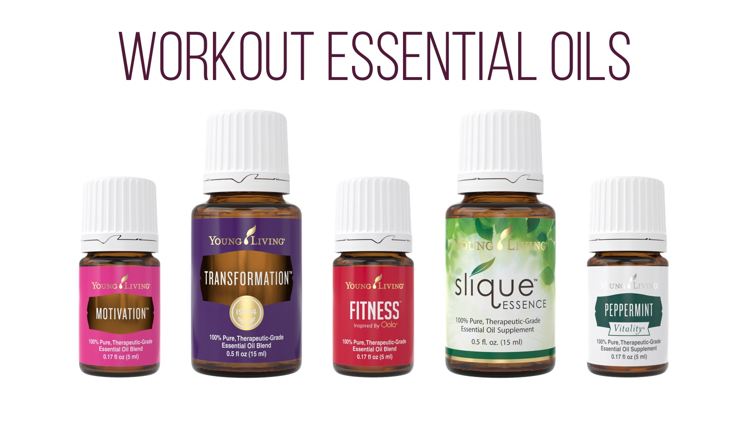

Slide 12
Notes:
The importance of staying hydrated cannot be understated, especially before you workout. Keeping your body properly hydrated helps flush out the toxins that are released when working out. Make sure to drink plenty of water 30 minutes before you work out and 4-6 ounces for every 30 minutes of exercise. Try adding in lemon, grapefruit, or orange eo to flavor your water and add benefits.

Slide 13
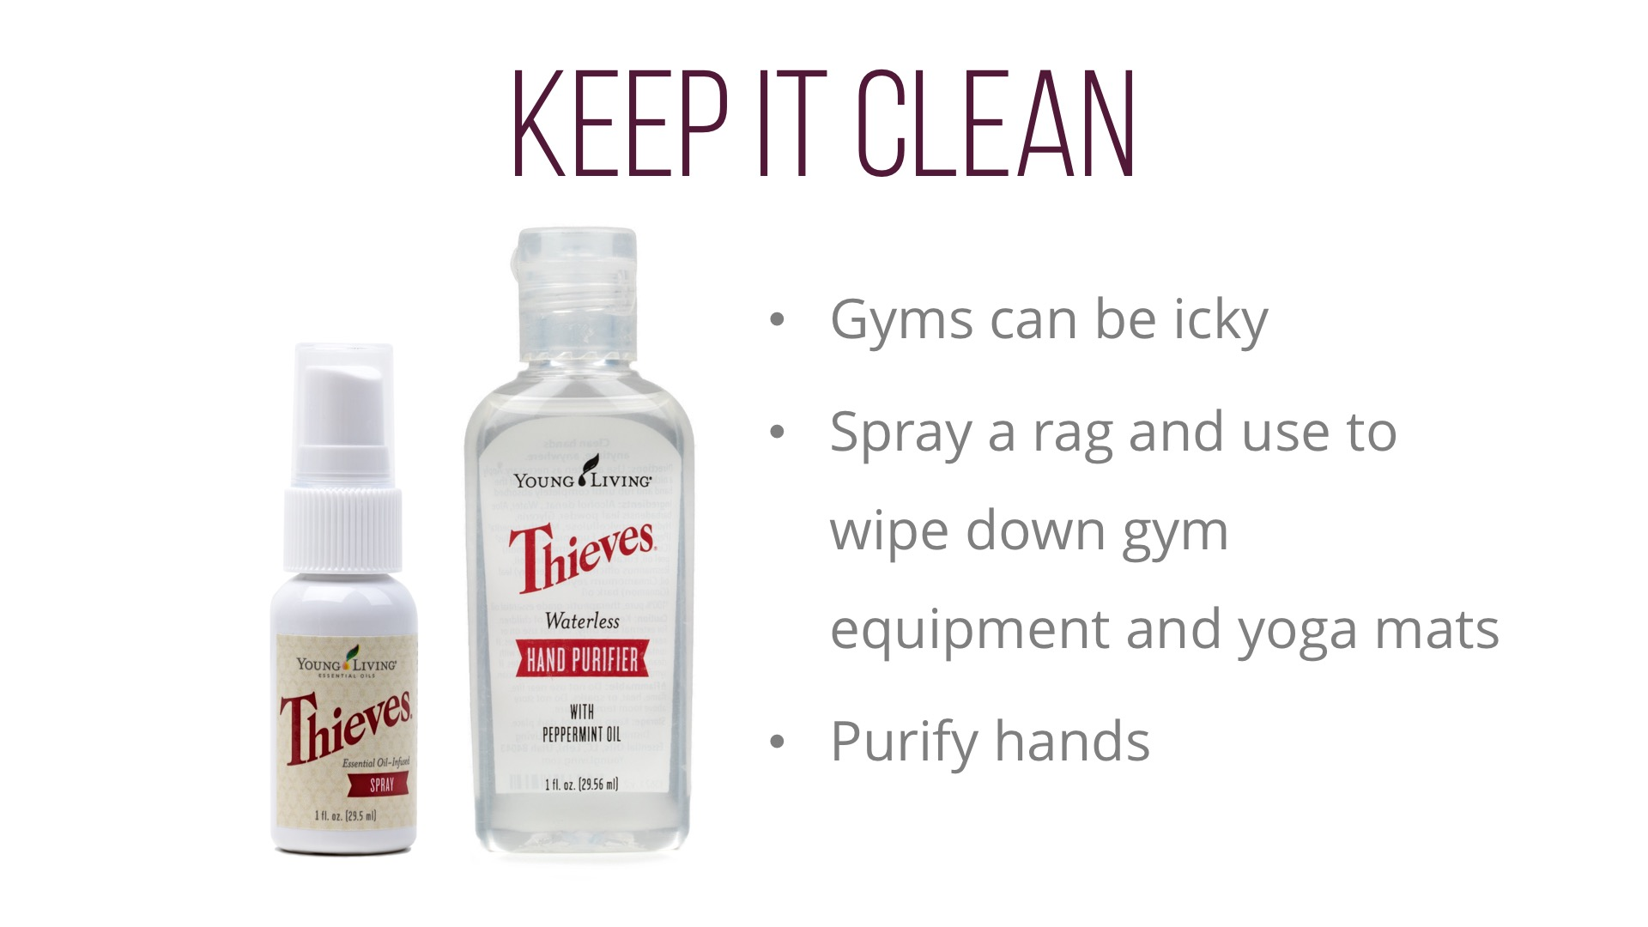
Notes:
Now we cant forget about our post workout essentials. lets face it, you may not be looking or smelling your best after a workout…… and that’s ok! I always say if you still look good after a workout you didn’t workout hard enough. YL has a few products that may not help you look better after a workout, but can definitely help you feel better.
If you are working out on a lunch break or have to get somewhere quick after a workout, try using citrus fresh or your favorite aromatic oil as a perfume or cologne to refresh and inspire.
My gym bag is never without these thieves products. They are perfect products to wipe down or spray your machines after a workout, use on your hands, in your car, use the spray to help freshen stinky gym bags, cleats, and shoes. They are so small, convenient, and make a huge difference.
You cant forget your Young Living lip balm, your lips may be left dry after exercing.

Slide 15
Notes:
Unless you are a yogi, most people do not stretch enough and dread it. Stretching is moving the joint in an effort to lengthen the muscle and it should maximize the joint’s range of motion, which is a very good thing.
Essential oils can be a great addition to your stretching routine for a unique exercise and relaxing experience.
Deep relief is one of my favorite oils to take with me to gym, when I am exercising out doors, or to throw in your child’s gym bag. It conveniently fits into any small bag and is very simple and easy to apply. It is already pre diluted with coconut oil and comes in a roll on bottle. Its fresh aroma is both invigorating and relaxing and is great for a massage after or during activity. Blended with peppermint oil, deep relief creates a cooling sensation when applied topically and it feels AMAZING.

Slide 17
Notes:
Pure Protein Complete is a blend of five high quality protein sources. Whey protein, Goats milk, Egg Whites, Peas, and Organic Hemp Seed. Hemp and Pea protein are considered complete proteins because they contains all eight essential amino acids in sufficient quantities to meet the body’s needs.
Because of the varied protein sources in the product, it provides all the major amino acids needed for the building and repair of various tissues in the body. Many of these amino acids, provided by the proteins, cannot be made by the body and have to be found through the diet. because of the varied proteins and amino acids in this product

Slide 18
Notes:
One serving Provides 25 grams of protein which is about 50% of your daily recommended value of Protein. That is more than 4 hard-boiled eggs.
The enzymes, probiotics, even the plant based proteins should be easier on the GI tract than the previous formula
In addition pp is also packaged with nutrients like B vitamins, calcium, zinc, and folate
PP now comes in two new flavors, Chocolate Deluxe and Vanilla Spice, they both taste great. I LOVE the chocolate and the vanilla tastes like a horchata.
Pure Protein Complete also contains a unique ingredient called ElevATP. I talked about ElevATP in the panel the other day, ElevATP is an ingredient used to increase energy in body in a natural way. It is a proprietary, clinically researched combination of ancient peat, which is fossilized plant trace minerals, and a polyphenol –rich apple extract that works with our body to stimulate the production of ATP.

Slide 20
Notes:
Young Living’s Cool Azul™ Pain Relief Cream provides cooling relief from minor muscle and joint aches, arthritis, strains, bruises, and sprains. Our plant-based formula combines the power of Wintergreen essential oil with our exclusive Cool Azul essential oil blend. With two powerful, synergistic active ingredients, this cream provides pain-relieving benefits in two ways: methyl salicylate found in Wintergreen helps alleviate pain deep in the muscles and joints, and natural menthol found in Peppermint provides a cooling effect. If you need relief without synthetic ingredients, Young Living’s Cool Azul Pain Relief Cream is the answer!

Slide 23
Notes:
Sulfurzyme is also an ideal workout supplement, as it can support good recovery time and help maintain a healthy response to acute inflammation associated with exercise.

Slide 24
Notes:
Especially beneficial for athletes, as well as middle-aged and elderly people who may experience a natural, acute inflammation response in their joints after exercise, AgilEase™ is a joint health supplement that’s perfect for healthy individuals who are looking to gain greater mobility and flexibility through the reduction of inflammation.
We used unique and powerful ingredients such as frankincense powder, UC-II undenatured collagen, hyaluronic acid, calcium fructoborate, and a specially formulated proprietary essential oil blend of Wintergreen, Copaiba, Clove, and Northern Lights Black Spruce—oils that are known for their joint health benefits. Take AgilEase to support joint health or as a preventative measure to protect joint and cartilage health.
For best results, take two capsules daily for joint support.*
Store in a cool, dark place.

Slide 26
Notes:
With botanicals from around the world, PowerGize helps sustain energy levels, strength, mental and physical vibrancy, and vitality when used in addition to physical activity.*
which is touted for its properties that support immunity, mental clarity, concentration, and alertness. Its custom formula helps support the male reproductive system.*

