Slide 1
Notes:
General tips as you begin
Be sure to introduce yourself and the class, even if you think everyone already knows. How long will the class be and what can the participant expect?
If the room is small enough, have everyone introduce themselves with their name, where they are from, and a fun fact.
Pause and ask for questions regularly throughout the class. If you do not know an answer, say so, and ask if anyone in the audience knows.
If people are falling asleep, make them stand up and move around. Ask them to teach each other and get them chatting
Slide 1
Example script: Hi, my name is Mandy and I am a mom, a nurse, and an executive leader with Young Living. Thank you so much for coming to the 3-month onboarding meeting tonight. This meeting will be about 40 minutes long and will cover all you need to know to get started using Young Living products for the first 3 months, as well as how to teach others about this 90-day wellness challenge. This is the next step in a journey to wellness that has changed my life and I know can changes yours too. Are you ready to go?!

Slide 2
Notes:
Slide 2
Example script: Onboarding is the process of getting someone started or familiarizing them with a company or products and services. For our meeting, the importance of onboarding is giving support to anyone that is new to Young Living and setting up a plan for them to discover the many benefits that are offered. By creating this onboarding plan, you can empower others to research products and find their “why” to wanting to choose healthier options for them and their families.

Slide 3
Notes:
Slide 3
Example script: Strategy #1 for our onboarding program is to know your customers. I know we spend all of our time trying to share Young Living with everyone, but it is important to be clear about who YOU want to work with. Who do you want in your tribe? Sharing with everyone positions you to reach no one. You cannot simultaneously support the needs of a young mom eager to make the best health and wellness decisions for her family and a male powerlifter interested in improving his performance.

Slide 4
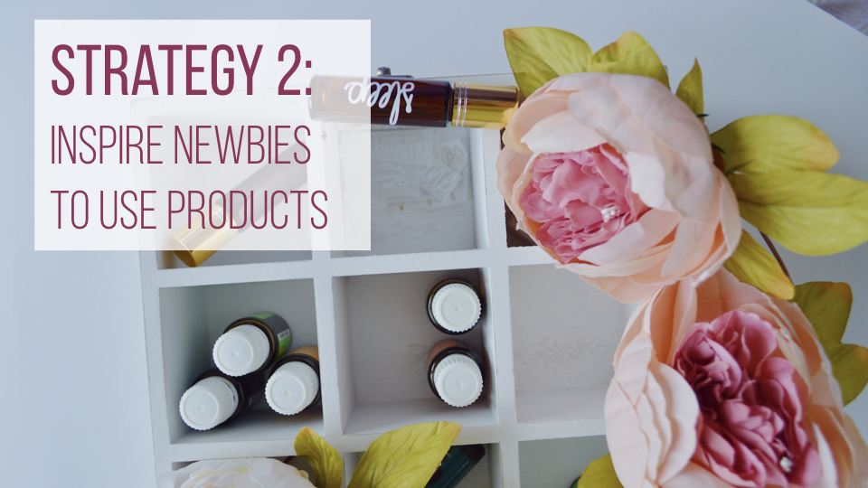
Notes:
Slide 4
Example script: Strategy #2 to developing a strong onboarding program is to inspire newbies to use the product. Sharing a love for the products and showing those around you how you use them will inspire others to create their own regimen.

Slide 5
Notes:
Slide 5
Example script: Strategy #3 is to create meaningful relationships. A meaningful relationship is a healthy and caring relationship that we could not live without. These are the people in our lives that bring value, help us grow and support us when needed. The best way to go about creating these types of relationships is through communication, respect, honesty, empathy, and purpose.

Slide 6
Notes:
Slide 6
Example script: Now using all three of the above strategies you will create a 3-month plan for yourself and those on your team new to Young Living. Know who your customer is, use the products and inspire others around you to do the same, create meaningful relationships by listening to their needs and developing a plan to build that relationship and meet the needs of those whom you are working with.

Slide 7
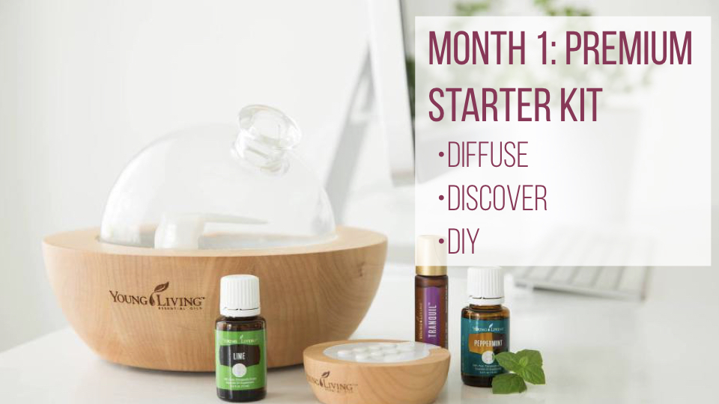
Notes:
Slide 7
Example script: Congratulations! You just enrolled someone and their PSK arrives. It’s month one of the onboarding process. During the first month, suggest that they open each oil in their kit and place them on the counter or somewhere visible every day. Make sure that they know to look below the oils and find all the additional items like NingXia Red® samples, roller fitments, and Thieves® spray.
The first way to get started using essential oils is to diffuse daily. Each morning challenge your team to start their diffusers first thing. Add oils that create an invigorating atmosphere like Citrus Fresh™, Thieves®, or Stress Away™.
Next is to discover your best way to use the oils. Is it diffusing, is it to gently introduce to skin and begin applying topically, is it adding to personal care products, or taking internally? Find the way that works the best for you.
The last challenge this month is DIY. Find a way to use the oils in the premium starter kit to create a product that you would normally purchase. Make a facial toner, body scrub, muscle rub, or a playdoh recipe for your kids.

Slide 8
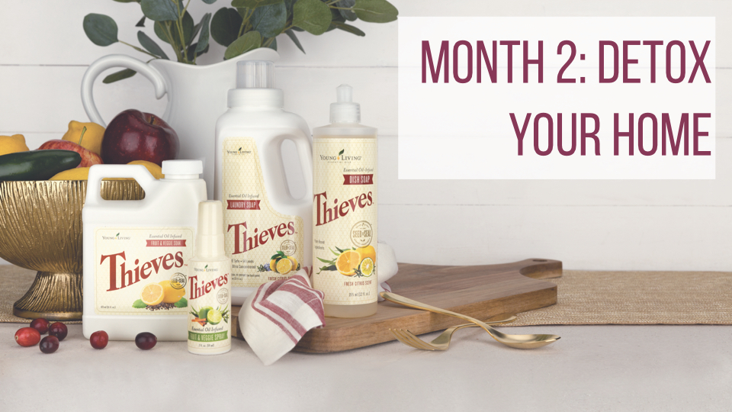
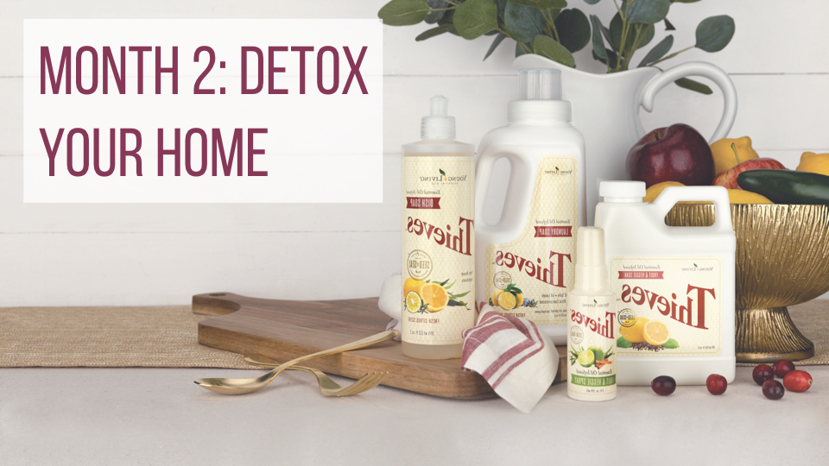
Notes:
Slide 8
Example script: Month two of our onboarding is to detox your home. Ditch the chemicals in your cleaning products that are the most harmful to your body by finding replacements with plant-based products. Simply switch out the products that you use the most often, like replacing the soap in your bathroom with Thieves® Foaming Hand soap. Take some time this month to research what ingredients you should be avoiding and find healthy plant-based alternatives.

Slide 9
Notes:
Slide 9
Example script: Thieves® Household Cleaner is the perfect place to start using plant-based cleaning products in your home. This concentrated cleaner is formulated without harsh chemicals and can clean every area of your home. Use it on your counters, window and mirrors, oven, toilet, and any surface that needs cleaning.
Let’s take a closer look at some of the chemicals that are commonly in cleaners and what they do to our bodies:
Phthlates (THAL-ates) are possible endocrine disruptors that can change hormone levels and cause birth defects. They also have been shown to be associated with allergies, insulin resistance, diabetes and obesity.
Triclosan has been associated with higher rates of allergies to both food and skin allergens. It can increase and decrease both estrogen and testosterone, and is known to pass into blood, urine and breast milk. Even worse, it can react with free chlorine in our water supply and form a byproduct that when exposed to the sun is converted into dioxins, and dioxins are known to be toxic to mammals, birds, and fish.
2-butoxyethanol has been shown to cause skeleton defects in fetal rats and can inhibit coordination.
Perchlorethylene is a central nervous system depressant and is a class 2 carcinogen.
Thieves® Household Cleaner is free of all these ingredients. So what exactly is in it that allows it to clean just as strongly?
Essential oils of clove, cinnamon bark, eucalyptus, rosemary, and lemon.
Sodium Methyl 2-Sulfolaurate/Disodium 2-Sulfolaurate derived from coconut oil is a mild, non-drying cleanser. The Cosmetics Database labels it as a surfactant and foaming agent.
Alkyl polyglycosides (APGs) are a class of non-ionic surfactants widely used in a variety of household and industrial applications. They are derived from sugars – usually glucose derivatives– and fatty alcohols.
Tetrasodium Glutamate Diacetate is a multi-purpose, clear, liquid chelating agent and preservative booster. It is made from readily biodegradable plant material with high solubility over a wide pH range.
The Thieves® cleaning line has a variety of products including; hand soap, dish soap, automatic dish soap, laundry soap, personal care products like toothpaste and mouthwash, and even hand sanitizer. Spend the second month of your onboarding adding in these plant-based alternatives in your daily cleaning routine.

Slide 10
Notes:
Side 10
Example script: Now that we have started using essential oils, and detoxed our home and cleaning products, the last month’s focus of this onboarding program is to craft a daily routine that will support your health and wellness journey.

Slide 11
Notes:
Slide 11
Example script: Start your day with NingXia Red®. This nutrient-dense supplement includes juices and extracts from blueberries, pomegranate, plum, and the exotic NingXia Wolfberry. This supplement provides energy support, supports normal cellular function and eye health, as well as contains powerful ingredients involved in the antioxidant process. Consume 1-2 oz. twice daily for optimal results.

Slide 12
Notes:
Slide 12
Example script: In a perfect world we would all consume a balanced diet and have all the necessary nutrients that our bodies need to function optimally. Unfortunately, several factors affect the way we consume and absorb the nutrients we need, from the environment they grow in, to how they are harvested, and even changes in our bodies over time.
Master Formula, Life 9™, Essentialzymes-4™, and Sulfurzyme® are the core four supplements that I would encourage you start taking daily to begin to feel your best.

Slide 13
Notes:
Slide 13
Example script: Master Formula provides premium vitamins, minerals, antioxidants and food-based nutriment to support general health and well-being. A nutriment is a nourishing substance that promotes growth, replaces loss, and provides energy.
Master Formula uses SSI technology (Synergistic Suspension Isolation). This process supports the delivery of different nutrients throughout the body by separating the ingredients and then combining them into three different capsules depending on how they work together.
Master Formula comes in pre-packaged sachets so that you can support your health and well-being conveniently on the go.

Slide 14
Notes:
Slide 14
Example Script: When the ratio of good bacteria and bad bacteria in our gut is unbalanced, it can affect our health in many different ways. Life 9™ is Young Living’s high potency probiotic. It contains 17 billion live cultures from 9 beneficial bacteria strains for full-spectrum gut health.
Billions of bacteria classified over a thousand different types live in our gut. The sole purpose of these bacteria is to aid in digestion by breaking down our meals into absorbable nutrients.
This seems like an easy enough ask, but modern toxins, overly processed foods, daily stress, and antibiotics can deplete and damage bacteria, harming the digestive process along the way.
Life 9™ is best taken at night and comes in a delayed-release capsule and a special bottle cap to better protect the beneficial bacteria. Keep refrigerated after opening.

Slide 15
Notes:
Slide 15
Example script: Essentialzymes-4™ is a multi-spectrum enzyme complex that aids in the digestion of dietary fats, proteins, fiber, and carbohydrates. Why do we need enzymes? They are responsible for every chemical reaction in our bodies, allow our cells to build up and break down molecules quickly, and drive vitamins, minerals, and hormones to serve the body.
Take Essentilazymes-4™ two times daily with largest meals. Each dose comes in one dual dose blister pack that contains a yellow immediate release capsule with proteases, amyleases, and phytases and a white targeted release capsule, which contains lipase and essential oils like ginger, fennel, and lemongrass.

Slide 16
Notes:
Slide 16
Example script: Sulfurzyme® combines wolfberry powder with MSM. Methylsulfonymethane (MSM) is the richest dietary source of natural sulfur needed by our bodies every day to maintain the structures of protein, protect cells and cell membranes, replenish the connection between cells, and preserve the molecular framework of connective tissue.
MSM supports the immune system, liver, circulation, gut, and scavenges for free radicals.
Sulfurzyme® comes in both a powder and a capsule form.

Slide 17
Notes:
Slide 17
Example script: The slides and scripting for today’s meeting came from Lindsey Elmore, and you can download them online at https://lindseyelmore.com/

Slide 18
Notes:
Again, thank you so much for coming tonight. My name is Mandy and I am an executive leader with Young Living. Please let me know what additional questions I can answer and save the date for our next meeting which will be at. . . .on this day and time. Good night everybody!

