Slide 2
Notes:
The first few months with Young Living are critical to ensuring that people experience the products, learn how to use them, and are free from adverse effects

Slide 4
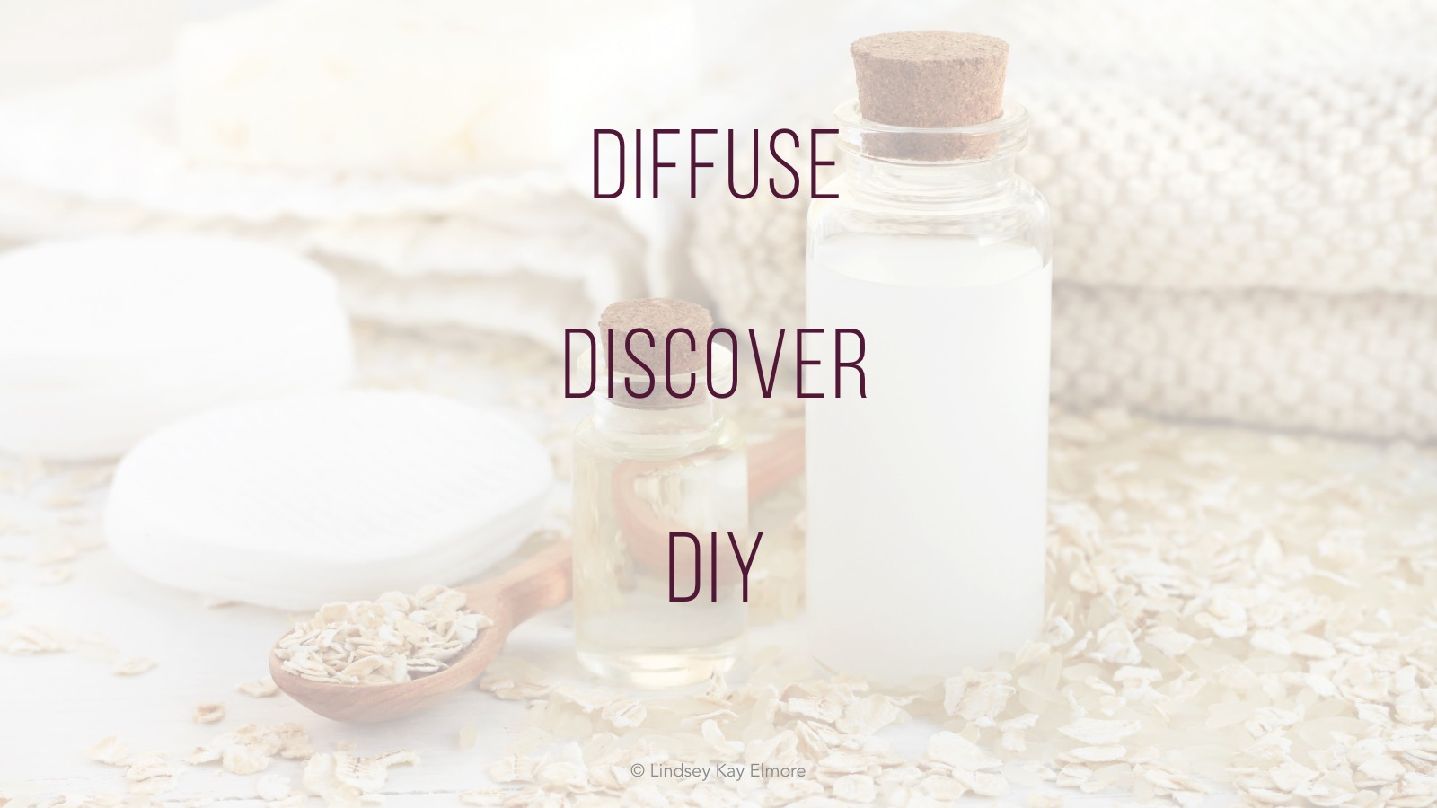
Notes:
Keep this section short—
Objectives
Diffuse!
Create 2 DIYs
Choose from
Body Scrub
Facial Toner
PlayDoh
Muscle Rub for Workouts
Gently introduce to skin
By mouth

Slide 6
Notes:
So what is in it?
Not all sulfates are created equal.
Sodium Methyl 2-Sulfolaurate/Disodium 2-Sulfolaurate. derived from coconut oil and is a mild, non-drying cleanser. The Cosmetics Database labels it as a surfactant and foaming agent
Alkyl polyglycosides (APGs) are a class of non-ionic surfactants widely used in a variety of household and industrial applications. They are derived from sugars, usually glucose derivatives, and fatty alcohols.
Tetrasodium Glutamate Diacetate is a multi-purpose, clear, liquid chelating agent and preservative booster. Tetrasodium Glutamate Diacetate is made from plant material, readily biodegradable, with high solubility over a wide pH range.

Slide 8
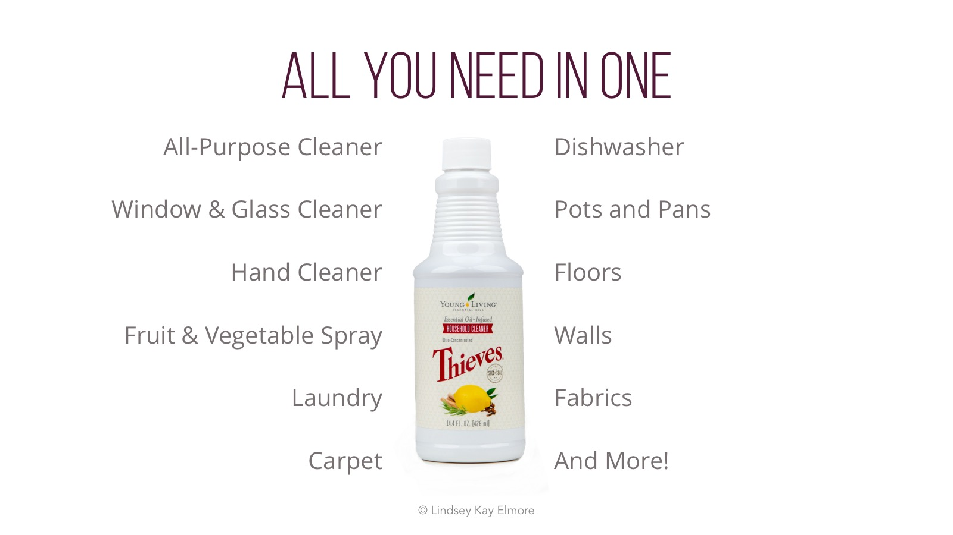
Notes:
Thieves Household Cleaner can be used on virtually any surface in your home or office, including fabrics, upholstery, carpet, floors, walls, dishes, and more.

Slide 9
Notes:
The dilution ratios on the label may be a little confusing at first. When diluting your cleaner, use the light degreasing ratio for light cleaning and more delicate surfaces. Use 1 tablespoon of cleaner to approximately 3 and 1/8 cups of water. Use the medium degreasing ratio to clean most surfaces and stains. This ratio is one tablespoon of cleaner to approximately 1 and 7/8 cups of water. For tough stains and dirt use the heavy degreasing dilution, which is about one tablespoon of cleaner to about 1 cup of water. You can also use Thieves cleaner directly on the problem area for really tough stains.

Slide 10
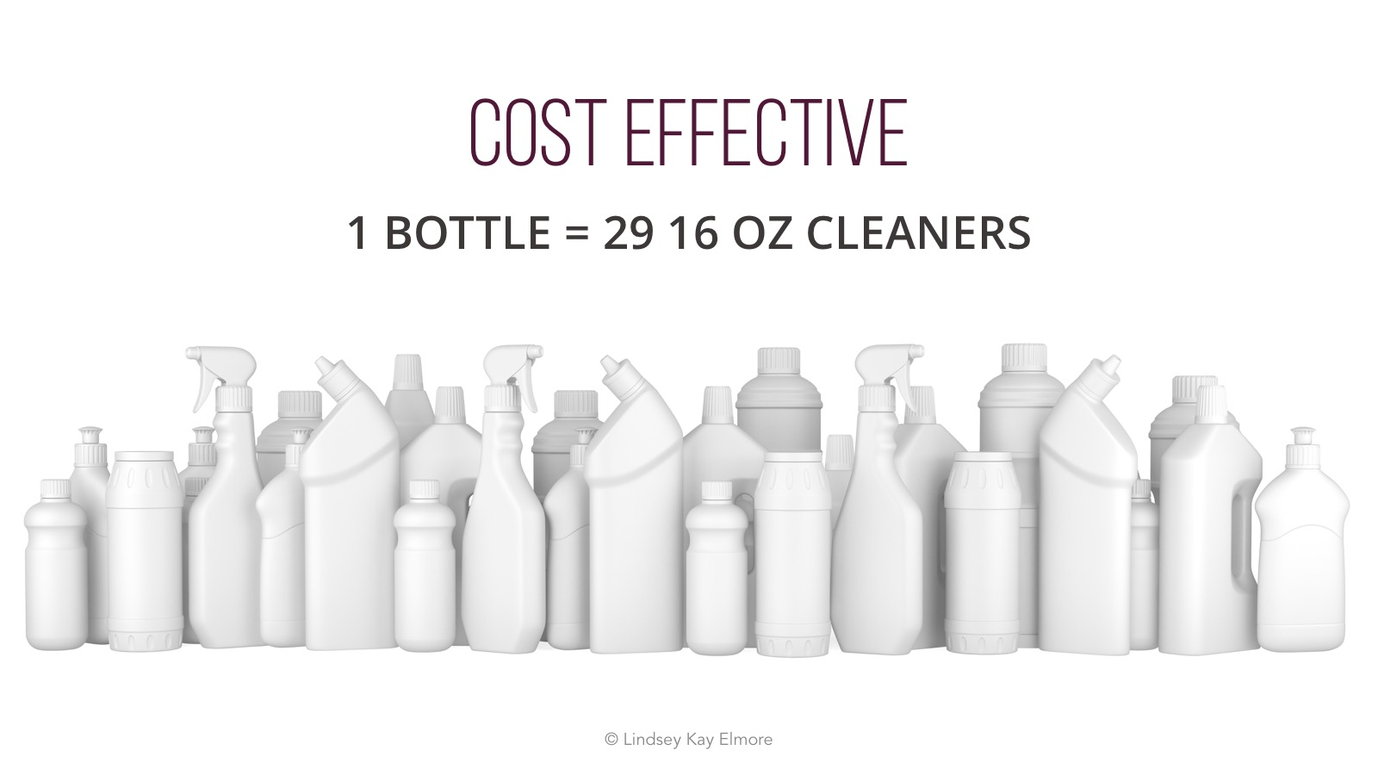
Notes:
Thieves cleaner comes in a concentrated form, which means it is very cost effective! Using the medium dilution ratio, you can make 29 16 oz. cleaners with one bottle of Thieves Household Cleaner.

Slide 12
Notes:
Cleans clothes without chemical or synthetic residue
HE safe
6X ultra concentrated (64 loads)
Natural enzymes
15-30% non-ionic surfactants; Fragrances [May contain: Benzyl bonzoate, Cinnamal, Cinnamyl alcohol, Citral, Citronellol, Eugenol, Farnesol, Geraniol, Isoeugenol, Limonene, Linalool]

Slide 13
Notes:
Alcohol denat., Water, Caprylic/capric triglyceride, Eugenia caryophyllus† (Clove) bud oil, Citrus limon† (Lemon) peel oil, Cinnamomum zeylanicum† (Cinnamon) bark oil, Eucalyptus radiata† leaf oil, Rosmarinus officinalis† (Rosemary) leaf oil, Lecithin, Polysorbate 80 (surfactant)
Small number of people are sensitive to polysorbate 80, may be risky in people with crohn’s disease. When injected into a rat belly, has been shown to have adverse effects on fertility, but only when injected 1-5 days after birth. May impact microbiome.
My advice is to use this as it is labeled and no use large amounts, especially via ingestion. I know some people choose to ingest Thieves spray as a throat spray. Please keep in mind that you are ingesting highly alcoholic ethanol that has been denatured to make it an undrinkable solution, so this is not recommended.
Triclosan and triclocarban are still allowed in hand sanitizers, despite little data that they have antibacterial effects and there is a wealth of evidence that there are health harms.

Slide 14
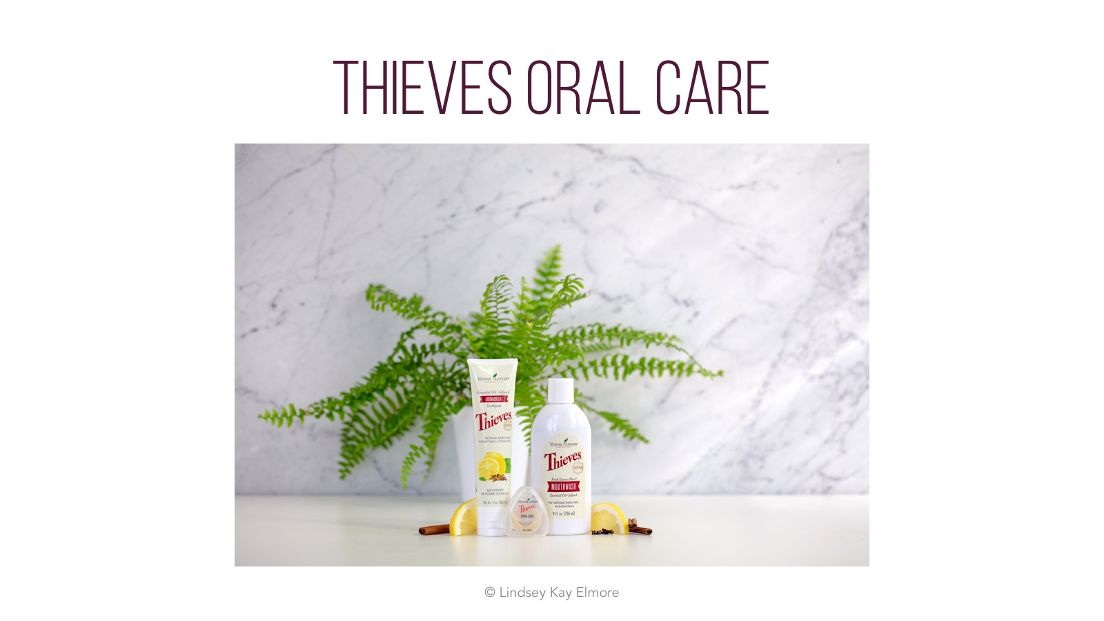
Notes:
Low abrasion particles
Liposomes stick to membranes and tooth enamel
Slowly release beneficial compounds and flavors overtime
Whitens
Brightens
Gentle and Strong
Slowly Releases Essential Oils
Alkalinizes
Supports Teeth and Gums
Supports Dental Hygiene

Slide 15
Notes:
Whitening and brightening
Time-released essential oil blend
Low abrasion particles

Slide 16
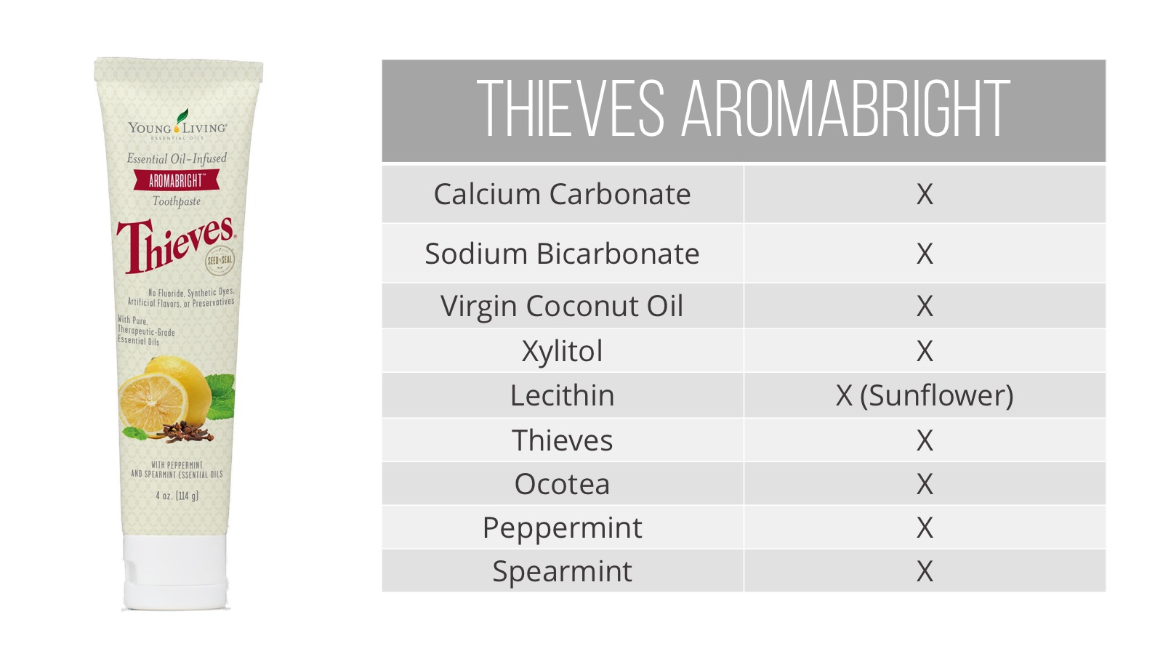

Slide 17
Notes:
Luxurious lather
Soft and clean skin

