Slide 3
Notes:
Responsible for every chemical reaction in our bodies
Allow our cells to build up and break down molecules quickly
Drive vitamins, minerals and hormones to serve the body
Diets, especially cooked processed foods, deplete enzymes
Even raw foods can inhibit enzymes
Illness, exercise, hot and cold temperatures
Enzyme levels drop with age, and excretion increases
Proteases and peptidases
Proteins into small peptides and amino acids
Lipases
Fat into three fatty acids and a glycerol molecule
Amylases
Starch and sugars into simple sugars such as glucose
Nucleases
Nucleic acids into nucleotides
Cellulase
Breaks down cell walls into simple sugars
Bromelain
Combination of 2 proteases found in pineapple
Phytase
Hydrolyzes phytic acid
Mouth
lingual lipase: Lipid digestion initiates in the mouth. Lingual lipase starts the digestion of the lipids/fats.
Salivary amylase: Carbohydrate digestion also initiates in the mouth. Amylase, produced by the salivary glands, breaks complex carbohydrates to smaller chains, or even simple sugars. It is sometimes referred to as ptyalin.
lysozyme: Considering that food contains more than just essential nutrients, e.g. bacteria or viruses, the lysozome offers a limited and non-specific, yet beneficial antiseptic function in digestion.
Haptocorrin (also known as R-factor): Helps with the absorption of Vitamin B12. After Vitamin B12 is released from its original carrier protein in the stomach, it gets bound to Haptocorrin. Haptocorrin protects it from acidic conditions of the stomach but is cleaved in the duodenum by pancreatic proteases. Vitamin B12 can then bind to intrinsic factor (IF) that has been produced by parietal cells. Finally, the IF-Vitamin B12 complex is taken up by in ileum via the cubam receptor.
Stomach
Pepsin is the main gastric enzyme. It is produced by the stomach cells called "chief cells" in its inactive form pepsinogen, which is a zymogen. Pepsinogen is then activated by the stomach acid into its active form, pepsin. Pepsin breaks down the protein in the food into smaller particles, such as peptide fragments and amino acids. Protein digestion, therefore, first starts in the stomach, unlike carbohydrate and lipids, which start their digestion in the mouth.
Hydrochloric acid (HCl): This is in essence positively charged hydrogen atoms (H+), or in lay-terms stomach acid, and is produced by the cells of the stomach called parietal cells. HCl mainly functions to denature the proteins ingested, to destroy any bacteria or virus that remains in the food, and also to activate pepsinogen into pepsin.
Intrinsic factor (IF): Intrinsic factor is produced by the parietal cells of the stomach. Vitamin B12 (Vit. B12) is an important vitamin that requires assistance for absorption in terminal ileum. Initially in the saliva, haptocorrin secreted by salivary glands binds Vit. B, creating a Vit. B12-Haptocorrin complex. The purpose of this complex is to protect Vitamin B12 from hydrochloric acid produced in the stomach. Once the stomach content exits the stomach into the duodenum, haptocorrin is cleaved with pancreatic enzymes, releasing the intact vitamin B12. Intrinsic factor (IF) produced by the parietal cells then binds Vitamin B12, creating a Vit. B12-IF complex. This complex is then absorbed at the terminal portion of the ileum.
Mucin: The stomach has a priority to destroy the bacteria and viruses using its highly acidic environment but also has a duty to protect its own lining from its acid. The way that the stomach achieves this is by secreting mucin and bicarbonate via its mucous cells, and also by having a rapid cell turn-over.
Gastrin: This is an important hormone produced by the "G cells" of the stomach. G cells produce gastrin in response to stomach stretching occurring after food enters it, and also after stomach exposure to protein. Gastrin is an endocrine hormone and therefore enters the bloodstream and eventually returns to the stomach where it stimulates parietal cells to produce hydrochloric acid (HCl) and Intrinsic factor (IF).
Gastric Lipase: Gastric lipase is an acidic lipase secreted by the gastric chief cells in the fundic mucosa in the stomach. It has a pH optimum of 3-6. Gastric lipase, together with lingual lipase, comprise the two acidic lipases. These lipases, unlike alkaline lipases (such as pancreatic lipase), do not require bile acid or colipase for optimal enzymatic activity. Acidic lipases make up 30% of lipid hydrolysis occurring during digestion in the human adult, with gastric lipase contributing the most of the two acidic lipases. In neonates, acidic lipases are much more important, providing up to 50% of total lipolytic activity.
Pancreas
Trypsinogen, which is an inactive(zymogenic) protease that, once activated in the duodenum into trypsin, breaks down proteins at the basic amino acids. Trypsinogen is activated via the duodenal enzyme enterokinase into its active form trypsin.
Chymotrypsinogen, which is an inactive (zymogenic) protease that, once activated by duodenal enterokinase, breaks down proteins at their aromatic amino acids. Chymotrypsinogen can also be activated by trypsin.
Carboxypeptidase, which is a protease that takes off the terminal amino acid group from a protein
Several elastases that degrade the protein elastin and some other proteins.
Pancreatic lipase that degrades triglycerides into fatty acids and glycerol.
Sterol esterase
Phospholipase
Several nucleases that degrade nucleic acids, like DNAase and RNAase
Pancreatic amylase that breaks down starch and glycogen which are alpha-linked glucose polymers. Humans lack the cellulases to digest the carbohydrate cellulose which is a beta-linked glucose polymer.
Small Intestine
Erepsin: It converts peptones and polypeptides into amino acids. Maltase: It converts maltose into glucose. Lactase: This is a significant brush border enzyme that converts lactose into glucose and galactose. A majority of Middle-Eastern and Asian population lack this enzyme. This enzyme also decreases with age. As such lactose intolerance is often a common abdominal complaint in the Middle-Eastern, Asian, and older population, manifesting with bloating, abdominal pain, and osmotic diarrhea. Sucrase: It converts sucrose into glucose and fructose.

Slide 4
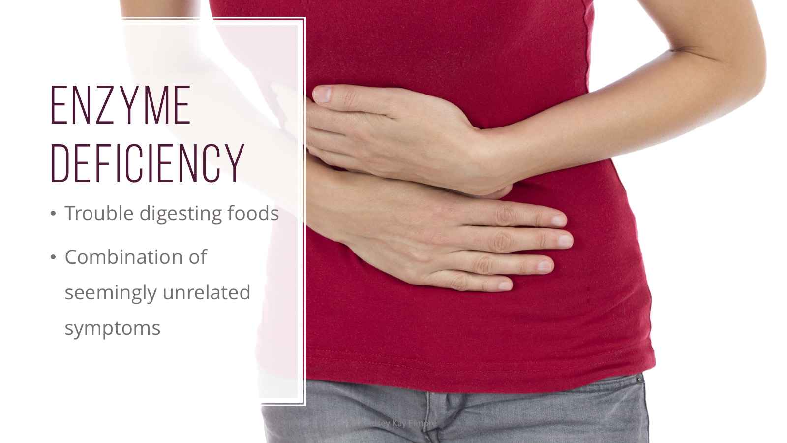
Notes:
Bacterial overgrowth in small intestine
Skin rashes, acne, eczema
Brain fog, headaches, moodswings
Joint and myofascial pain

