Slide 1
Notes:
Hi, my name is _____, and I am an independent distributor of Young Living Essential Oils. Today we are going to learn about Young Living—our history, our values, and our company, as well as discover what essential oils are and how to use them and explore the oils that are in the Starter Kit.

Slide 3
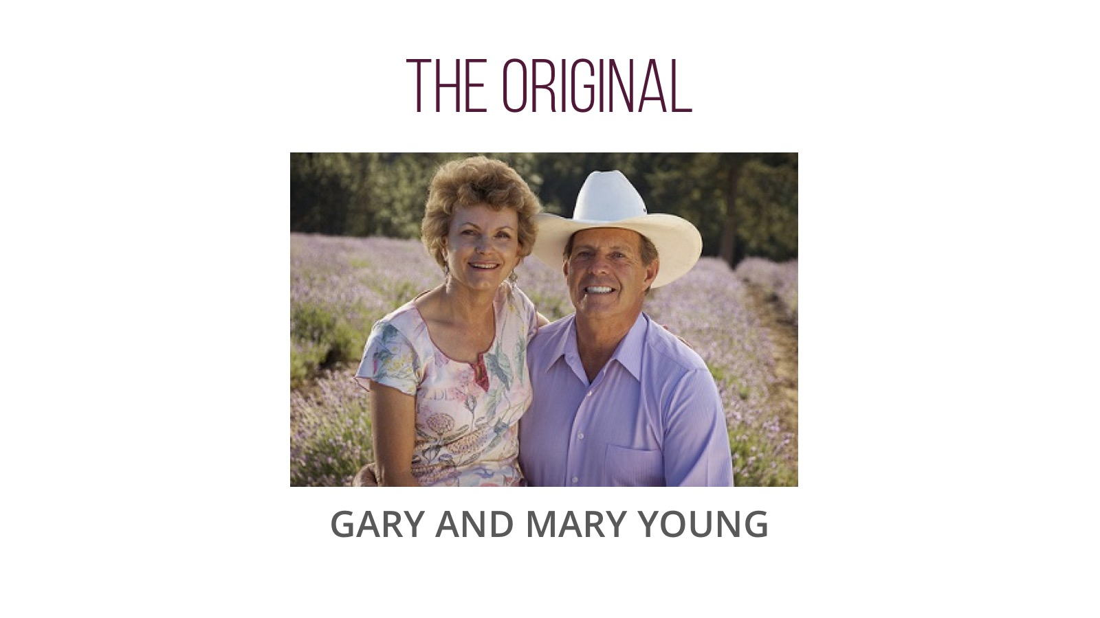

Slide 4
Notes:
So what is an essential oil?
Essential oils are the aromatic liquids found within shrubs, flowers, trees, roots, bushes, resins, and seeds. Some people like to call essential oils “nature’s living energy” because they contain unique constituents that provide a host of benefits.
Most essential oils are extracted from plant sources using steam distillation and are highly concentrated, making them far more potent than dried botanicals.
Essential oils are volatile, which means that the scent of the oil rises quickly into the air.
They are also versatile, with a wide variety of uses. Some people use essential oils to enliven an environment, support different body systems, or just for their great scents. However you choose to use essential oils, chances are someone else has tried that same use in the past. If you still don’t know where to start, rest assured that each essential oil is labeled with instructions for use.

Slide 5
Notes:
Young Living’s commitment to quality starts with seeds. The seeds we use are selected for their ability to become botanicals with high levels of bioactive compounds.
We then grow the seeds using cultivation practices that are dedicated to responsible and sustainable growing and harvesting methods.
Next, we distill using a gentle, proprietary technique for steam extracting essential oils and preserving their precious constituents.
To guarantee consistent, verifiable quality, our oils are tested in Young Living’s own internal labs, as well as in third-party facilities.
Finally, each essential oil is carefully bottled and labeled using state-of-the-art equipment.

Slide 6
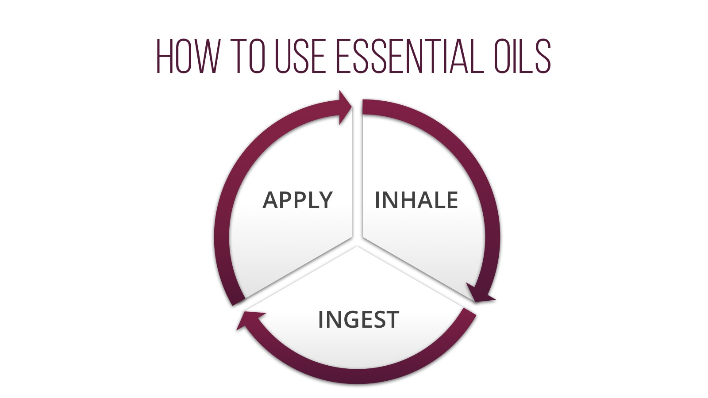
Notes:
Since everyone here is relatively new to essential oils, let’s talk about how they can be used. There are three ways to use essential oils. You can use some oils aromatically, some topically, and some can even be taken internally.

Slide 7
Notes:
One of my favorite ways to use essential oils is aromatically. Many of us have had a time where a smell triggers a memory—freshly baked bread, pine needles, or spring flowers can easily take you back to positive times in your life. Essential oils are the same!
Let’s all use my favorite oil aromatically. I love ________ essential oil because it smells like___________. Using it is as easy as one, two, three:
Place a couple of drops in the palm of your hand.
Rub your hands together.
Cup your hands over your nose and mouth and inhale deeply.
Diffusion is another great way to use essential oils aromatically. By creating a fine aromatic mist, diffusers allow you to create a spa-like atmosphere and enjoy the benefits of essential oils in any environment. Young Living offers a wide variety of diffusers, and when you enroll as a new member, you will receive a diffuser in your Premium Starter Kit.

Slide 8
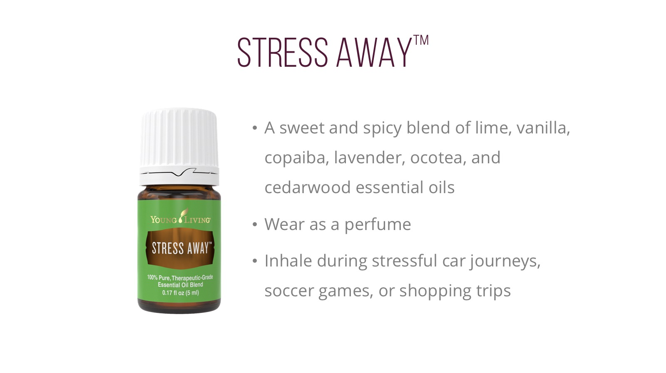
Notes:
Stress Away is a great-smelling blend that: [READ SLIDE]
It also includes the naturally occurring constituents beta-caryophyllene, alpha-humulene, limonene, cedrol, and linalool.

Slide 11
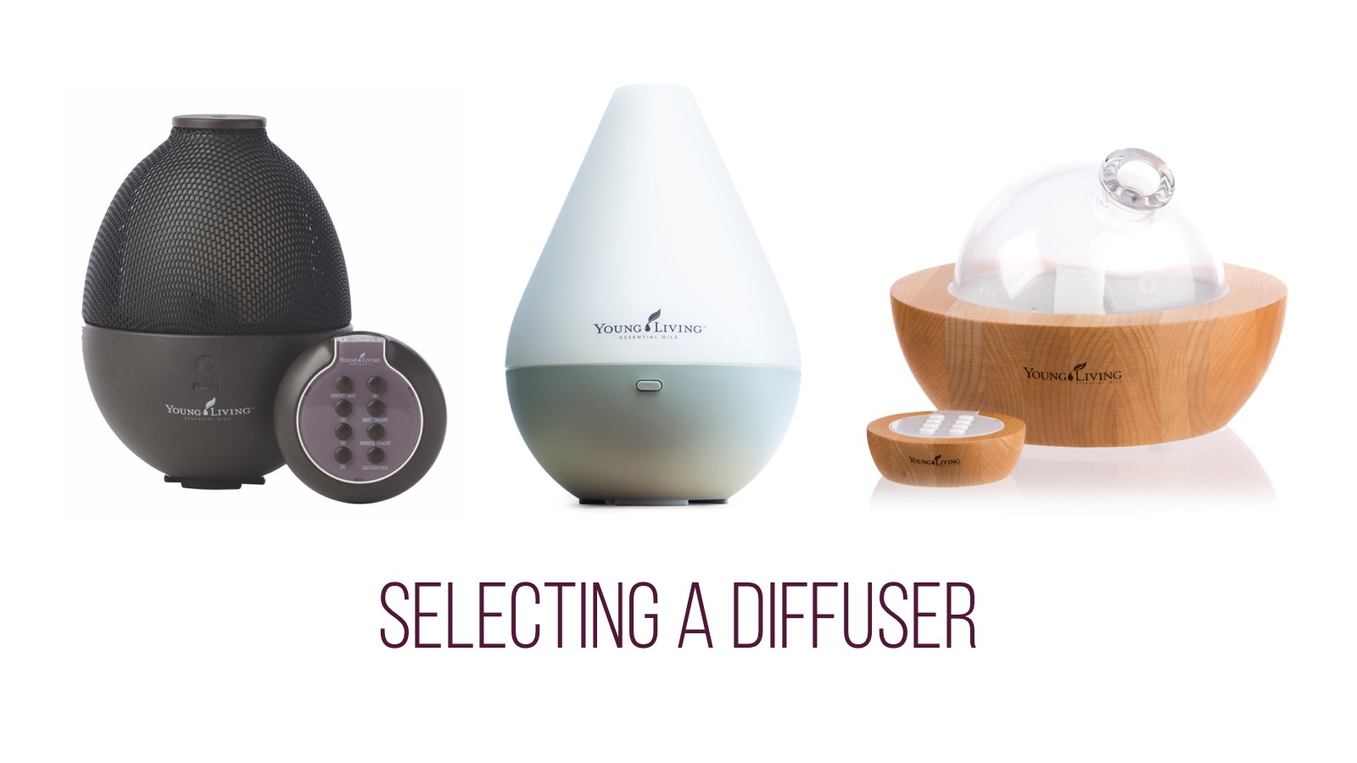

Slide 12
Notes:
Purification is a blend of Citronella, Lemongrass, Rosemary, Melaleuca Alternifolia, Lavandin, and Myrtle. It’s a very versatile blend that can be used to: [READ SLIDE]
You can also use Purification by:
Adding to Young Living Bath & Shower Gel Base
Adding 4 drops to a cup of Epsom salt for a soothing foot soak
Adding to distilled water in a spray bottle to use when traveling to freshen the air

Slide 13
Notes:
Essential oils can also be applied to the skin. This is known as topical application. Topical application is a great way to support your skin because essential oils are easy to use and provide quick benefits. If you have never used essential oils, one great area of the body to apply them topically is to the feet.

Slide 14
Notes:
R.C. is a blend of three types of Eucalyptus, plus Myrtle, Marjoram, Pine, Lavender, Cypress, Black Spruce, and Peppermint essential oils. It includes the naturally occurring compounds linalool acetate, linalool, camphene, and eucalyptol, and it can can be used to: [READ SLIDE]

Slide 15
Notes:
PanAway combines Peppermint, Wintergreen, Clove, and Helichrysum and is one of our best-selling blends. [READ SLIDE]
It also includes the naturally occurring constituents methyl salicylate, gamma-curcumene, menthol, and eugenol.

Slide 19
Notes:
In addition to all these uses, Frankincense may also help smooth the appearance of healthy-looking skin. It includes the naturally occurring constituent alpha-pinene and is a key ingredient in many products, including Boswellia Wrinkle Cream, Brain Power, Awaken, Highest Potential, and Forgiveness—favorite products for many members.

Slide 21
Notes:
Some people choose to use essential oils internally by adding them to water or liquid, placing them in a capsule, or taking one of Young Living’s oil-infused products. Peppermint, for example, can help promote healthy bowel function and support overall digestion when taken internally.
[TIP: You may want to make a batch of NingXia Red punch by adding half NingXia Red and half club soda with a few drops of your favorite essential oil, such as Orange, Lemon, or Tangerine, and pass around samples.]

Slide 22
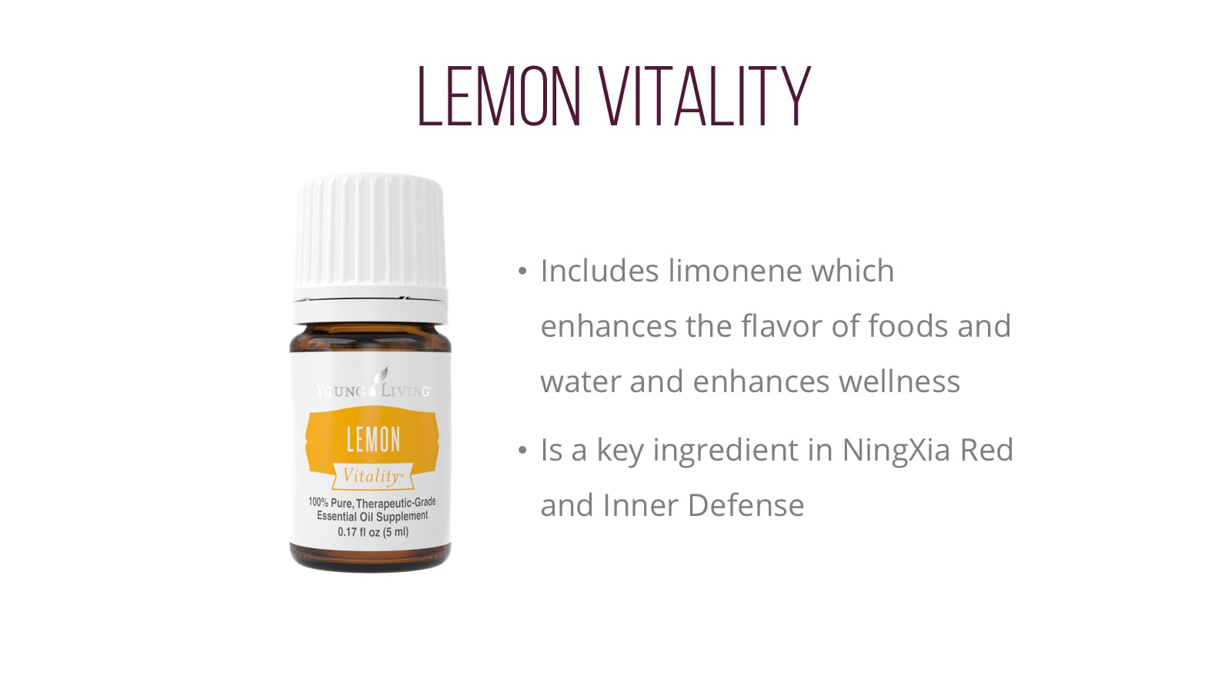

Slide 23
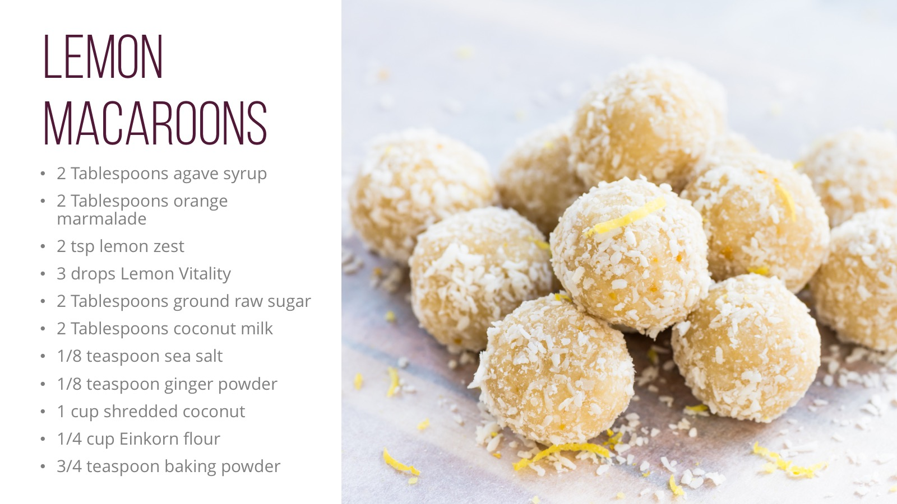

Slide 24
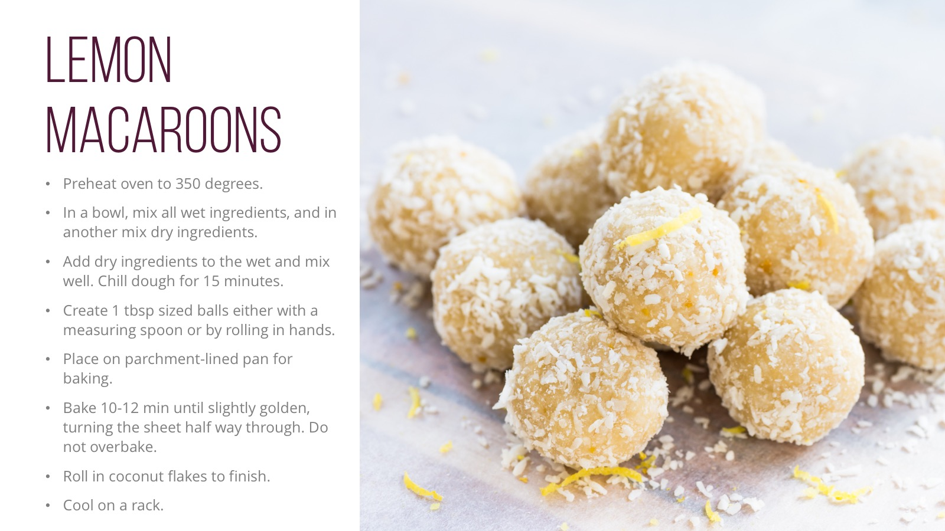

Slide 25
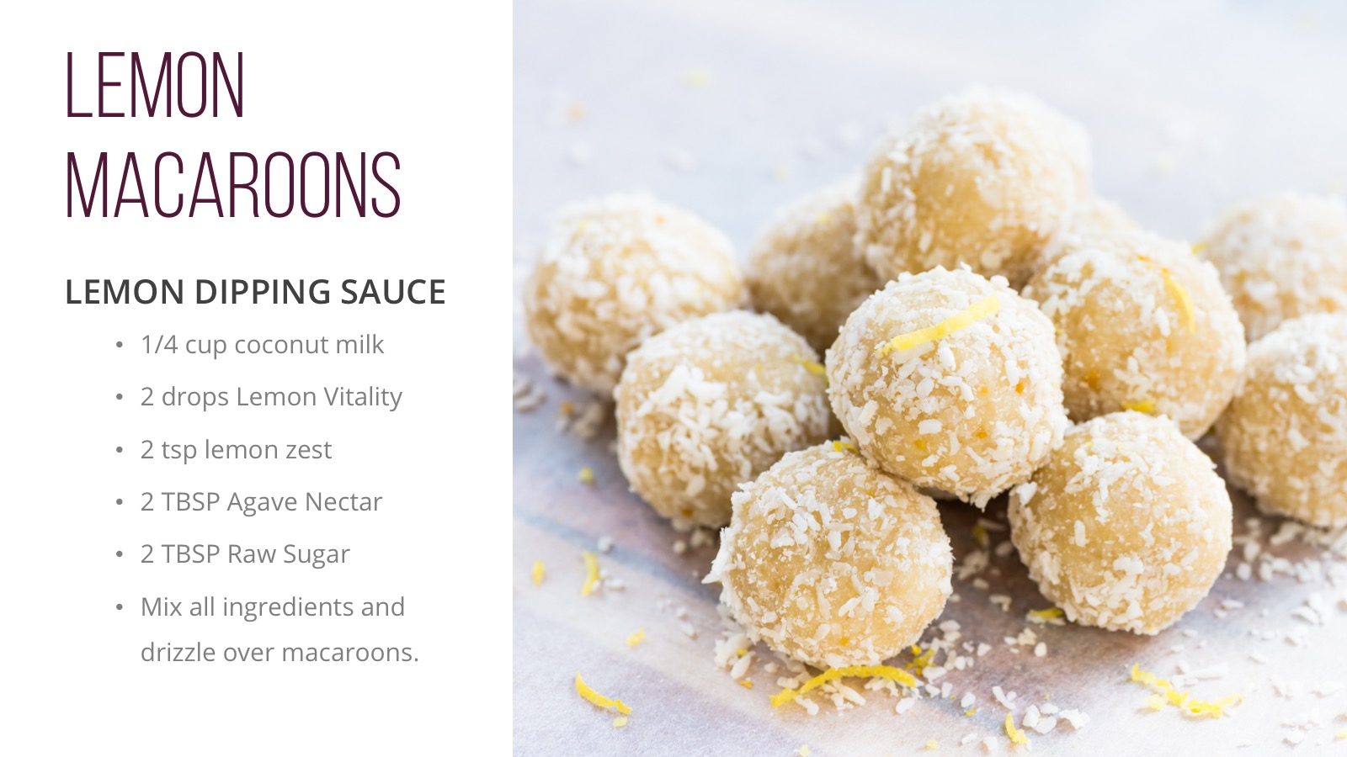

Slide 26
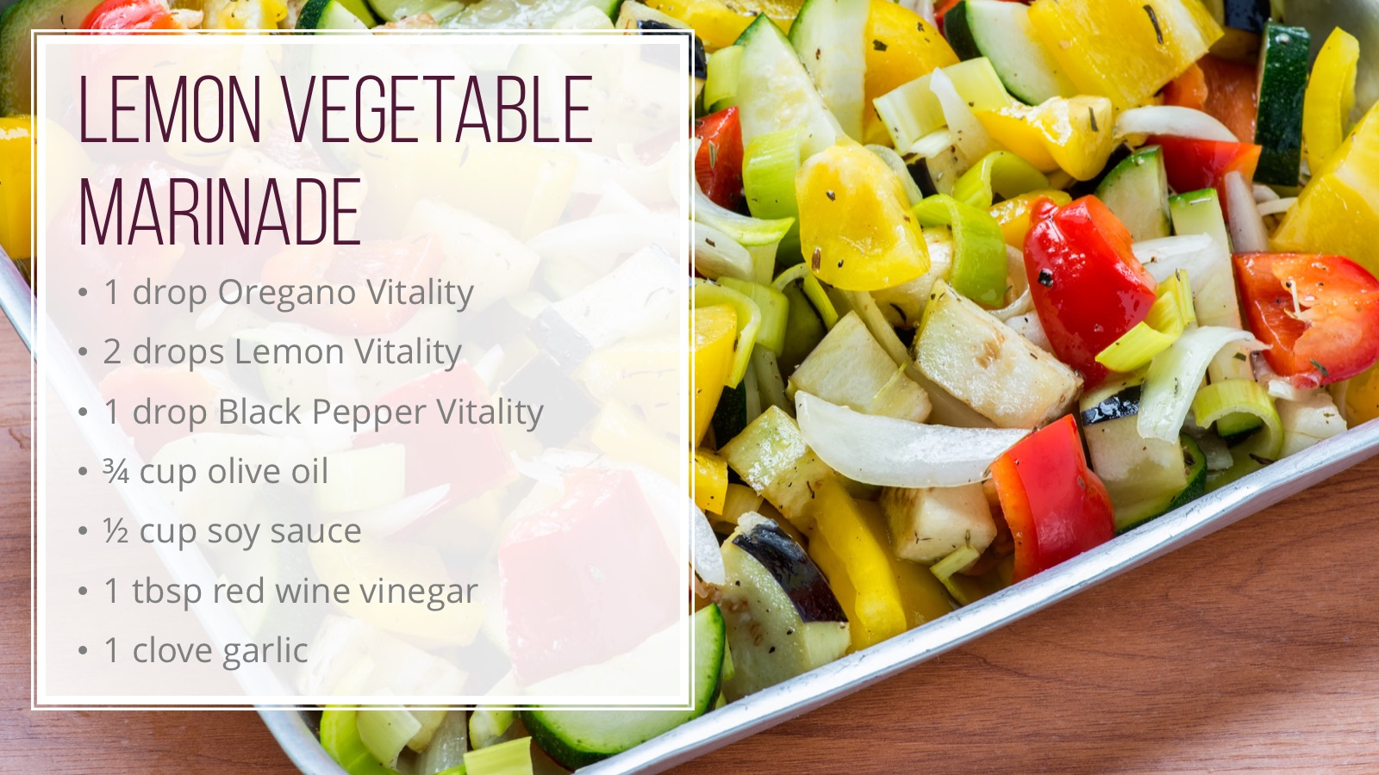

Slide 28
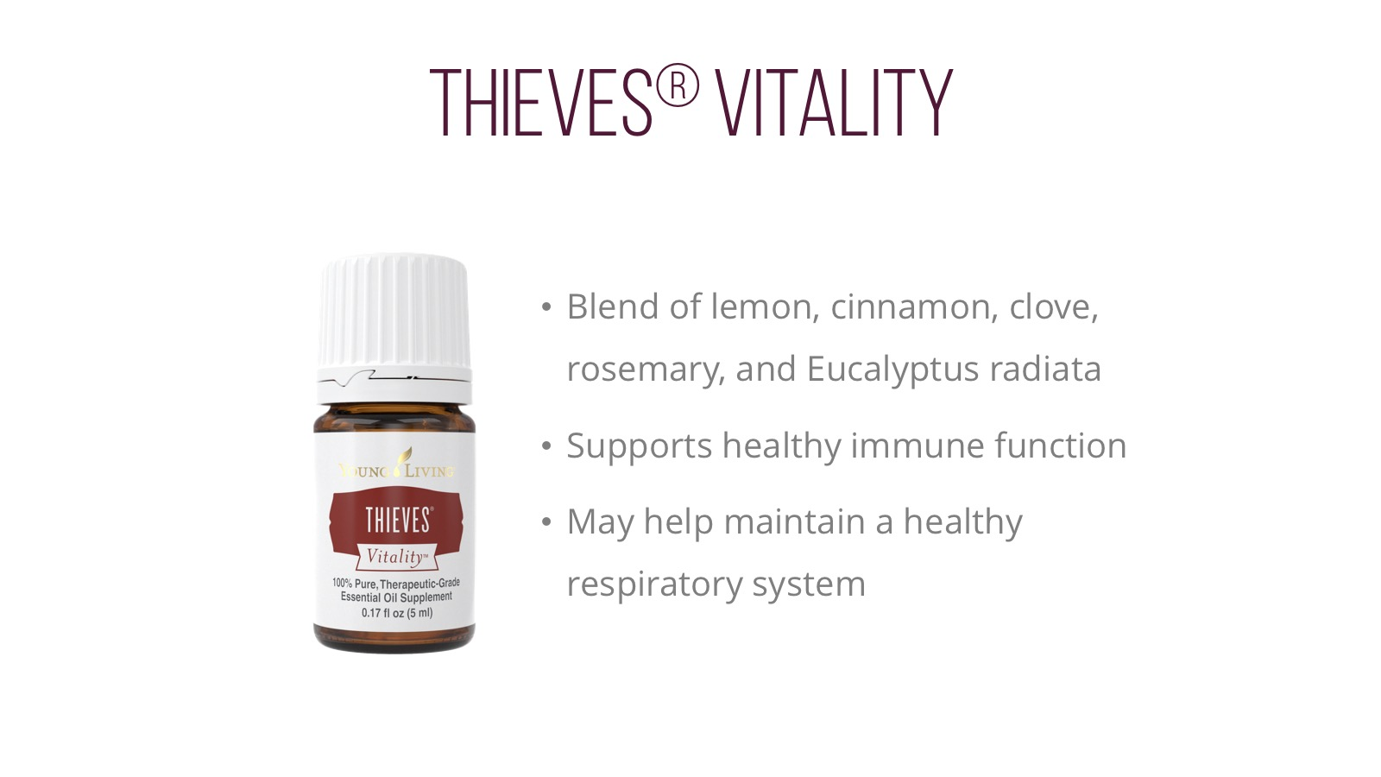
Notes:
Thieves is a blend of Lemon, Cinnamon, Clove, Rosemary, and Eucalyptus Radiata. Many people love Thieves because: [READ SLIDE]
There are so many ways to use Thieves:
Add to food or beverages to enhance their flavor.
Add a drop to hot drinks to add a spicy zing. (Clove, Lemon, Cinnamon, Rosemary)
Includes Clove, which was used traditionally as a spice for flavoring food.
Use 1 drop Thieves and 2 drops Orange as a refreshing flavor to complement your favorite beverage.
Add 1 drop to a cup of warm water as part of a wellness regimen.
Thieves contains oils that have been extensively researched:
Includes the naturally occurring constituent limonene. (Lemon, Eucalyptus Radiata, Rosemary)
Includes the naturally occurring constituent eugenol. (Clove, Cinnamon)
Includes the naturally occurring constituent eucalyptol. (Eucalyptus Radiata, Rosemary)

Slide 29
Notes:
Next is Copaiba. [READ SLIDE]
Copaiba is also great for mixing with honey and warm water to create a tea.
[TIP: Copaiba is pronounced KOH-PIE-EE-BA.]

Slide 32
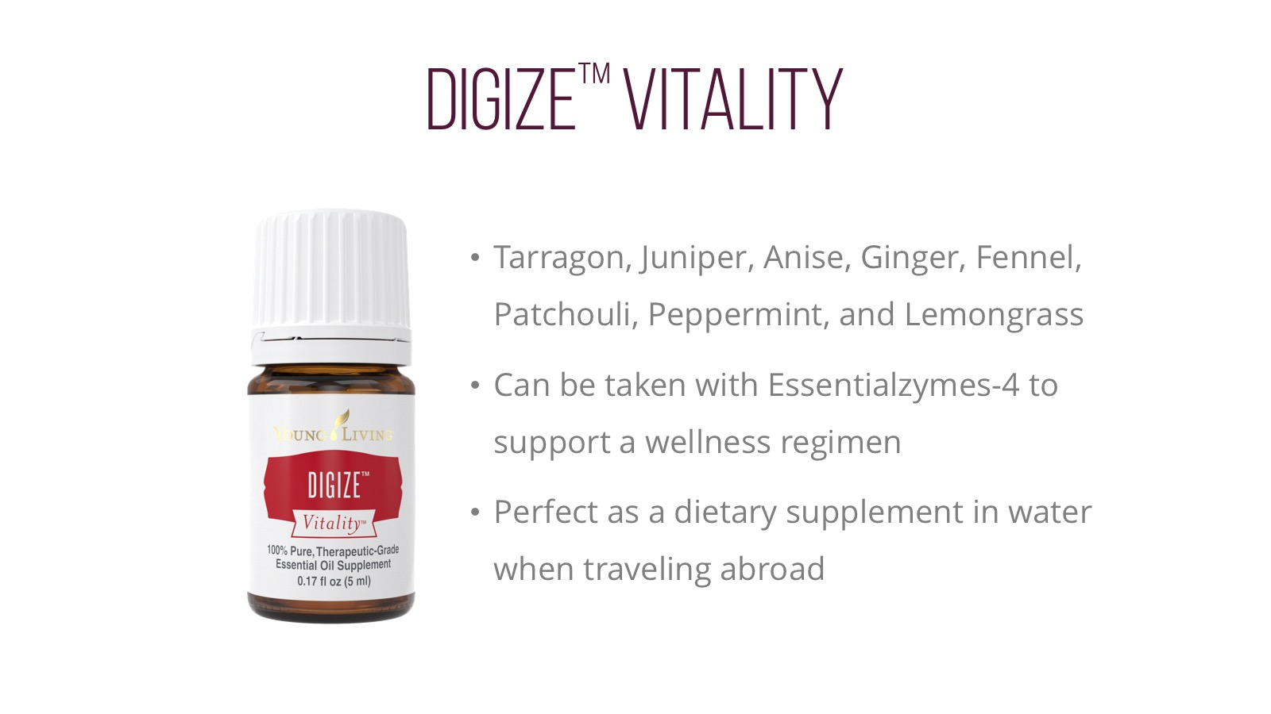
Notes:
DiGize contains Tarragon, Juniper, Anise, Ginger, Fennel, Patchouli, Peppermint, and Lemongrass essential oils. [READ SLIDE]
DiGize can be used in a variety of ways:
1. Add to a gel capsule.
2. Add 2 drops DiGize and 1 drop Peppermint to water for a stimulating beverage.
6. Add 2­–3 drops to honey for a tasty snack.
7. Includes the naturally occurring constituents of menthol, citrol, and zingiberene.

Slide 33
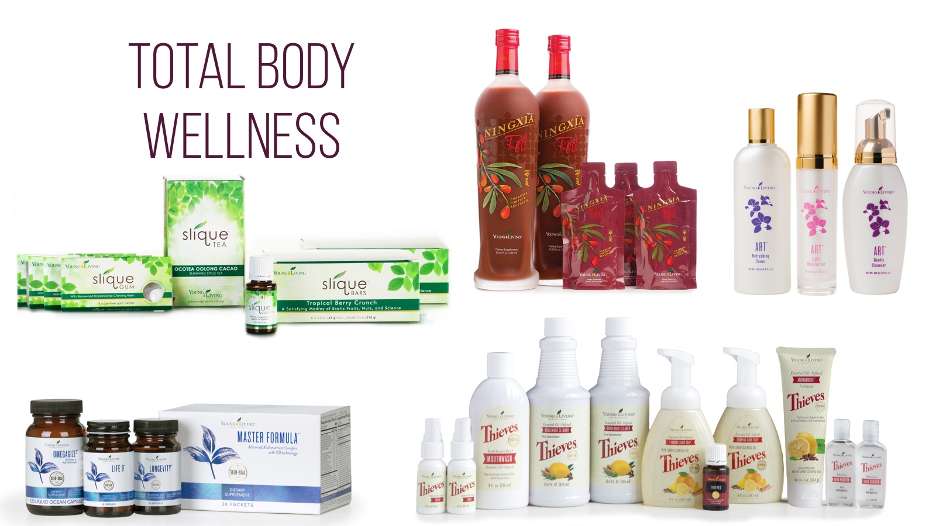
Notes:
First and foremost, we are a wellness company. We are committed to helping you live your healthiest life. True wellness starts from within, and Young Living offers an extensive array of nutrition products and essential oils to support wellness. In order to help you live a toxin-free lifestyle, Young Living offers personal care and household products to ensure that you and your family can benefit from naturally derived products for every part of your day.

Slide 36
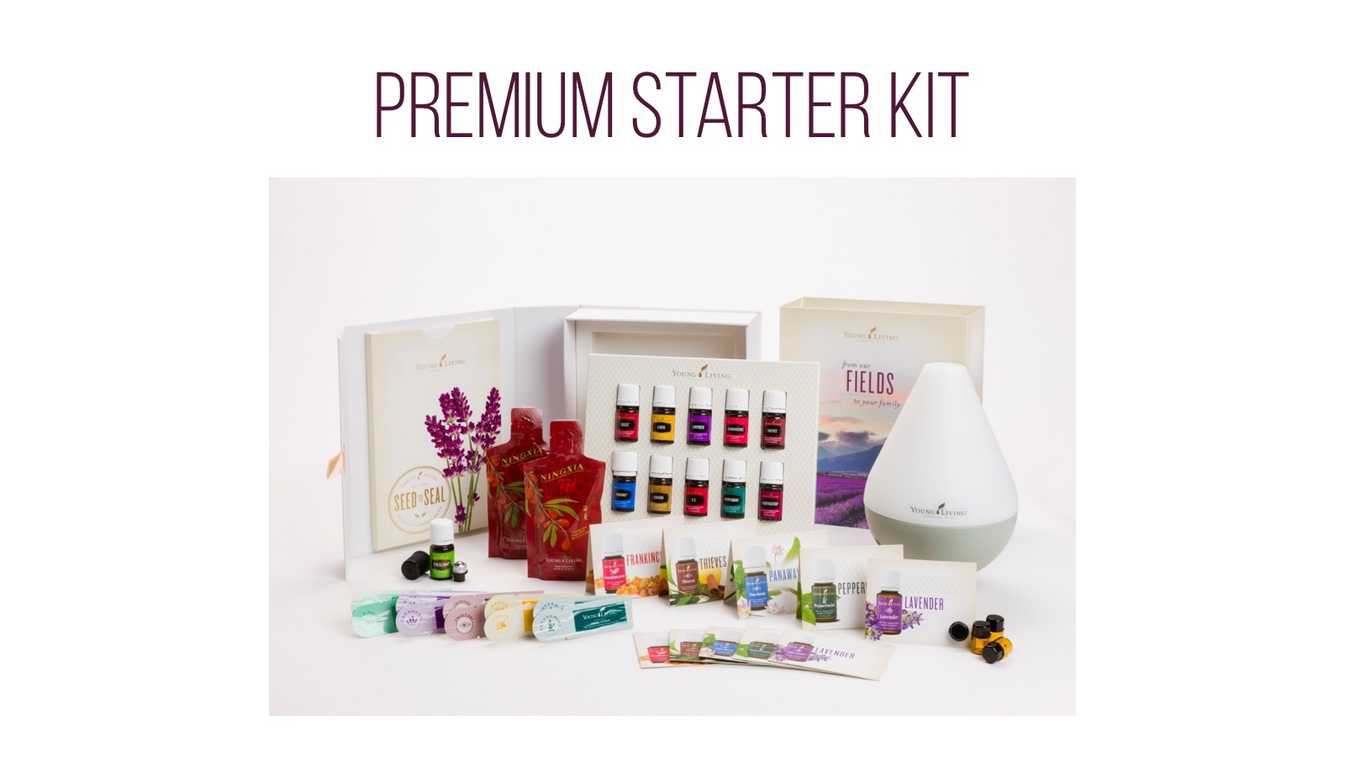
Notes:
So how can you get started? One of the best ways is with the Premium Starter Kit. In the kit, you receive some of our most popular essential oils; a diffuser; sample packets of NingXia Red; and shareable materials, including sample packets, a roller ball, and more. It’s everything you need to discover the products for yourself and get immersed in the Young Living lifestyle. Let’s check out some of the oils in the Starter Kit.
[TIP: Have the oils ready to pass around the room and let people experience them firsthand.]

