Slide 4
And the Lord God planted a garden eastward in Eden; and there he put the man whom he had formed.
- GENESIS 2:8

Slide 5
Joseph, the youngest son of Jacob is the favorite of his father.
His brothers hate him and cast him into a pit, and then sell Joseph to traders
Joseph finds favor with the Pharaoh, elevated to second hand to the king
Famine strikes Israel and Joseph’s brothers come to Egypt to buy fruits
- GENESIS 37-50

Slide 7
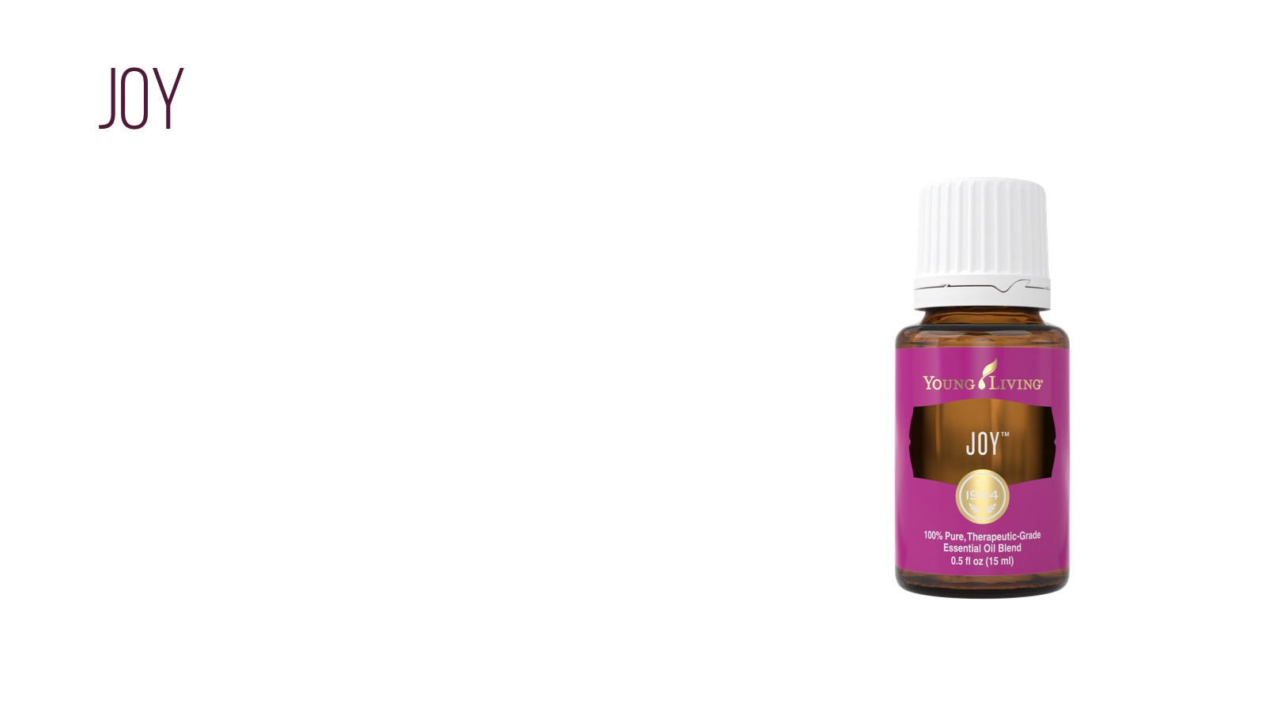
To appoint unto them that mourn in Zion, to give unto them beauty for ashes, the oil of joy for mourning, the garment of praise for the spirit of heaviness; that they might be called trees of righteousness, the planting of the Lord, that he might be glorified.
- ISAIAH 61:3

Slide 9
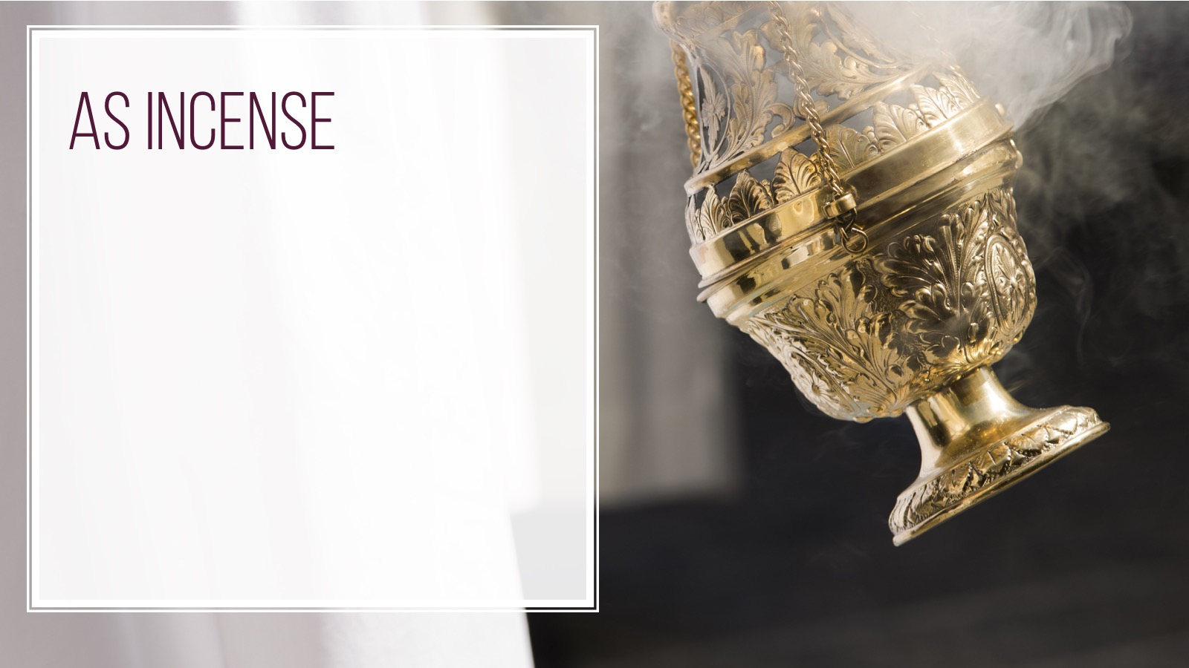
May my prayer be set before you like incense; may the lifting of my hands be like the evening sacrifice.
- PSALM 141:2
Notes:
This definition comes from the Merriam-Webster Dictionary

Slide 10
The Lord spoke unto Moses saying: Take thou also thee principal spices of myrrh, Five hundred shekels, of sweet cinnamon, half as much, an even two hundred-fifty shekels and of Sweet calamus two hundred fifty shekels, Of cassia five hundred shekels, after the shekel of Sanctuary, and of oil olive an hin And thou shalt make it an oil of holy ointment, an Ointment compound after the art of the apothecary: And it shall be an holy anointing oil.
- EXODUS 30:22-25
Notes:
Anointing oils are used by elders in churches to give blessings to people for many different reasons

Slide 14
Notes:
Reverence to anoint the body of Jesus with this oil
John 19:38-39
And after this Joseph of Arimathaea, being a disciple of Jesus, but secretly for fear of the Jews, besought Pilate that he might take away the body of Jesus: and Pilate gave him leave. He came therefore, and took the body of Jesus.
And there came also Nicodemus, which at the first came to Jesus by night, and brought a mixture of myrrh and aloes, about an hundred pound weight.

Slide 15
And there came also Nicodemus, which at the first came to Jesus by night, and brought a mixture of myrrh and aloes, about an hundred pound weight.
- JOHN 19: 38-39

Slide 16
Notes:
Cinnamon and cassia are two species of the same plant genus, and they are in the same family as Bay Laurel. Always have V6 at the meeting to help you protect learners
Great to place on the bottoms of the feet

Slide 17
All thy garments smell of myrrh, and aloes, and cassia, out of the ivory palaces, whereby they have made thee glad.
- PSALM 45:8
Notes:
Also found in the holy anointing oil

Slide 19
And he spake of trees, from the cedar tree that is in Lebanon even unto the hyssop that springeth out of the wall: he spake also of beasts, and of fowl, and of creeping things, and of fishes.
- 1 KINGS 4:33

Slide 21
He heweth him down cedars, and taketh the cypress and the oak, which he strengtheneth for himself among the trees of the forest: he planteth an ash, and the rain doth nourish it.
- ISAIAH 44:14

Slide 23
And when they were come into the house, they saw the young child with Mary his mother, and fell down, and worshipped him: and when they had opened their treasures, they presented unto him gifts; gold, and frankincense and myrrh.
- MATTHEW 2:11
Notes:
Possible used on or around the body of Jesus

Slide 24
Notes:
In the first Passover Moses asked elders of Israel to sacrifice a lamb and used the branches of hyssop to apply the blood of the lamb to the door posts of their dwellings. In Christian understanding, evil spirits and men passed throughout he town that night and claimed the lives of all firstborn sons except those saved by the lamb’s blood. In this way, hyssop was used to save the Israelites from danger in this evening

Slide 25
Purge me with hyssop, and I shall be clean: wash me, and I shall be whiter than snow.
- PSALMS 51:7
Notes:
A psalm of David after he laid with Bathsheba..

Slide 26
Notes:
Offered to Jesus when he arrived to Golgotha to be crucified. First and last to be used during the life of Christ

Slide 28
I have perfumed my bed with myrrh, aloes, and cinnamon.
- PROVERBS 7:17
Notes:
Used in Esther’s bridal preparation, massaged for 6 months before and anointed on the day of her wedding. Emotionall myrrh may bring feelings of security and well being.

Slide 30
And that they should publish and proclaim in all their cities, and in Jerusalem, saying, Go forth unto the mount, and fetch olive branches, and pine branches, and myrtle branches, and palm branches, and branches of thick trees, to make booths, as it is written.
- NEHEMIAH 8:15

Slide 32
And the Lord said unto Moses, Take unto thee sweet spices, stacte, and onycha, and galbanum; these sweet spices with pure frankincense: of each shall therebe a like weight:
- EXODUS 30:34

Slide 34
I am the rose of Sharon, and the lily of the valleys.
- SONG OF SOLOMON 2:1

Slide 35
We should share with those who are open and receptive
Skip over those who are unwilling to receive the good news
It is a reflection on them, not you
- MARK 6: 10-13
Notes:
We who use and promote oils are carrying forward the work of ancient scripture and traditions
Mark 6:10-13
We should share with those who are open and receptive
Skip over those who are unwilling to receive the good news
It is a reflection on them, not you

